Slide 1
Increasing student motivation through inquiry based learning
Grade 8 Science
Holy Trinity High School

Slide 2
It is extremely worthwhile for teachers to consider motivation when planning for instruction, because research has shown that a teacher’s style can and does affect student motivation to learn science (Tuan et al., 2003)

Slide 3
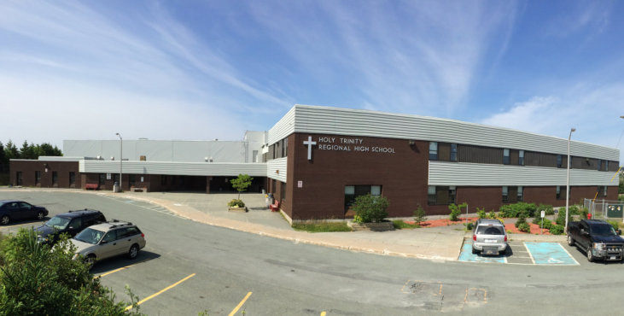
Holy Trinity High School
Notes:
Holy Trinity High School is located in Torbay,NL and serves the communities of the Bauline, Flatrock, Pouch Cove, and Torbay Currently, the school has a population of approximately 785 students with 48.5 teachers and 10 support staff. Our school offers a diversified educational program for students of all abilities from Grade 7 to Level III in both English and French Immersion streams.

Slide 4
Background information

Slide 5
Kerri Mercer
Began her teaching career in 2012
Joined HTH in 2014
Junior High French Immersion Science and Core French.
B.A (French Major, Math Minor) at Memorial University
B.Ed (Intermediate/Secondary) at Memorial University.
M.Ed in Curriculum Teaching and Learning at Memorial University.
Notes:
Began her teaching career in 2012 and joined HTH in 2014. Kerri has taught mostly Junior High French Immersion Science and Core French. Currently she teaches French immersion Science in Grade 8 & 9 as well as Core French (9, 1200). She completed a B.A (French Major, Math Minor) at Memorial University and went on to complete a B.Ed (Intermediate/Secondary). Currently she is completing M.Ed at Memorial in Curriculum Teaching and Learning.

Slide 6
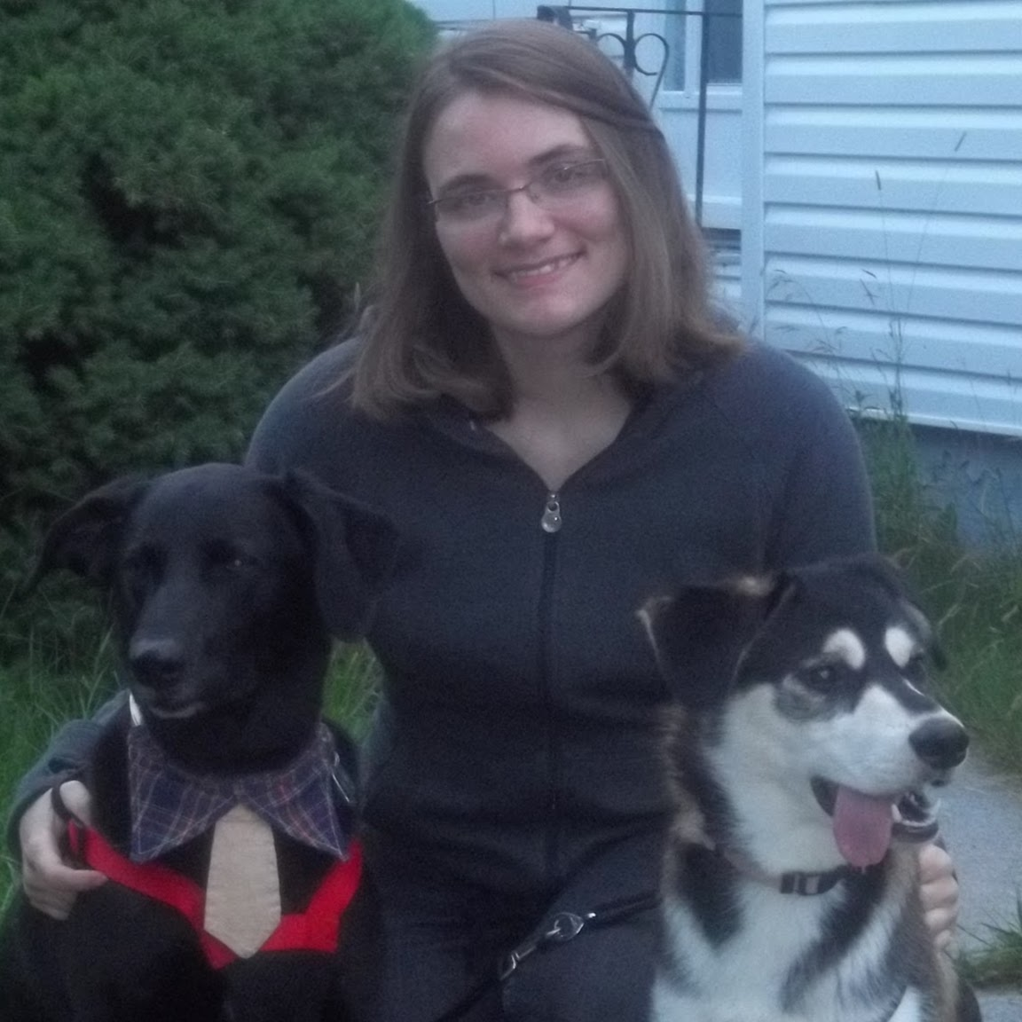
Natalie Lushman
Started teaching in 2011
Joined HTH in 2015
Was incorporated into the TIA before ever entering her classroom.
Science 7, 8 and Science 2200 and Earth Systems
B.Sc (Biology Major, Geography Minor) at Memorial University
B.Ed (Intermediate/Secondary) at Memorial University.
M.Ed in Curriculum Teaching and Learning.
Notes:
started teaching in 2011 and joined HTH this year where she was incorporated into the TIA before ever entering her classroom. She is teaching Science 7, 8 and Science 2200 and Earth Systems in High school. Right now she is also working on her masters in Curriculum Teaching and Learning.

Slide 7
Glenn Normore
Started his teaching career in Nain, Labrador in 1979.
Junior High level most of career
Currently: Grade 8 Math and Science and Robotics 3205.
Received Prime Minister’s Award for Teaching Excellence
Older that Natalie and Kerri combined :-)
Notes:
Started his teaching career in Nain, Labrador in 1979. Most of his teaching career has been at the junior high level which he finds energizing. Currently he is teaching Grade 8 Math and Science and Robotics 3205.

Slide 8
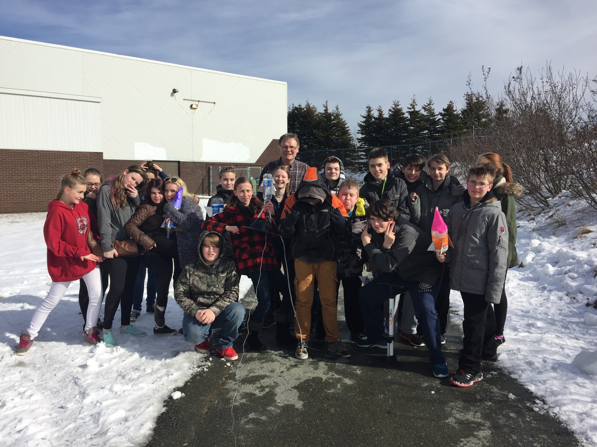
Our Classrooms
4 Grade 8 Science classes
3 English stream classes and 1 French Immersion class
Class size 22-30 students.
Diverse backgrounds.
Notes:
Four Grade 8 Science classes participated in this project. Three English stream classes and a French Immersion class ranging in size from 22-30 students. Students were of diverse backgrounds.

Slide 9
Our Beliefs
Fun for both the teacher and learner.
It is often difficult to reach every student in the class (to keep them motivated).
Success= finding meaning and purpose.
Students must construct their new learning from previous knowledge but before learning happens students must be motivated to engage.
A messy classroom is an inviting classroom!
Notes:
Education can be fun for both the teacher and learner. As this can look like many different things depending on the student, it is often difficult to reach every student in the class (to keep them motivated). In order for successful learning to occur students need to find meaning and purpose in what they are doing in each subject. We believe that students must construct their new learning from previous knowledge but before learning happens students must be motivated to engage. A messy classroom is an inviting classroom!

Slide 10
Our Reasoning
We all share a common interest in creating a classroom where students explore and discover science through hands-on learning.
Silence and seat work are not an everyday occurrence in our rooms so we decided to take our interest in activity-based learning and allow students to engage, explore and explain fluids on their own.

Slide 11
Focus Area

Slide 12
Our Focus and Why
Focus:
Motivation in Grade 8 Science
Why:
All three teachers involved teach Grade 8 Science and are concerned with students not only being able to achieve in Science, but wanting to develop an interest in science for years to come

Slide 13
“When students are invited to take part in the learning process from start to finish, they experience a sense of agency and responsibility for their learning, an approach that lends itself to greater student engagement and intrinsic motivation” (Ryan & Deci, 2000).

Slide 14
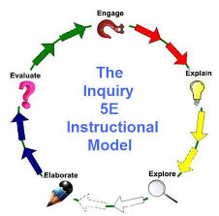
Resources that helped us narrow our focus
Science Scope : 5 E’s
Notes:
Science Scope which modelled the 5 E’s that we used in many of our activities. We also researched online, textbooks for ideas on interactive labs and especially for the aquaponics. We also gained ideas from previous projects on the TIA website and from our meetings with Tom Walsh which helped us understand and focus our ideas.

Slide 15
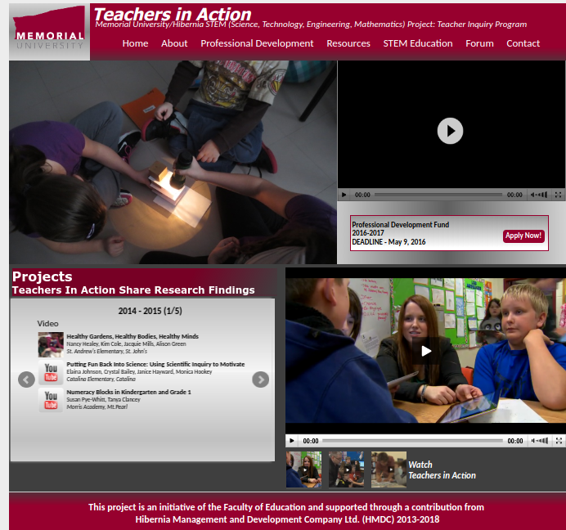
Resources that helped us narrow our focus
TIA website & meetings with Tom Walsh
Notes:
We also gained ideas from previous projects on the TIA website and from our meetings with Tom Walsh which helped us understand and focus our ideas.

Slide 16
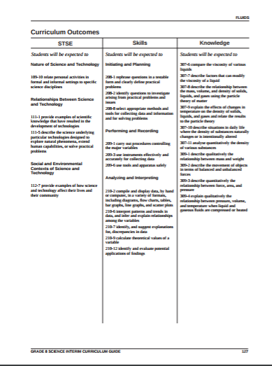
Aligning our project with school based work/research
Grade 8 Science curriculum
extended activities.
The aquaponics
a larger school-wide project on agriculture-aquaponics-robotics
school science project.
Notes:
The inquiry based unit on fluids came directly from the Grade 8 Science curriculum but went deeper as we extended activities. The aquaponics portion of our project-based learning was incorporated into a larger school-wide project on agriculture-aquaponics-robotics and many grade 8 students were key participants in this venture. Some students utilized their involvement in aquaponics as their school science project.

Slide 17
Research Questions

Slide 18
Research Questions
Teacher: How has my value for hands-on learning increased? How will this change how I teach?
Student: How does inquiry-based learning enhance motivation in Grade 8 Science?

Slide 19
Did Questions Change?
Questions evolved that made us question our pedagogy.

Slide 20
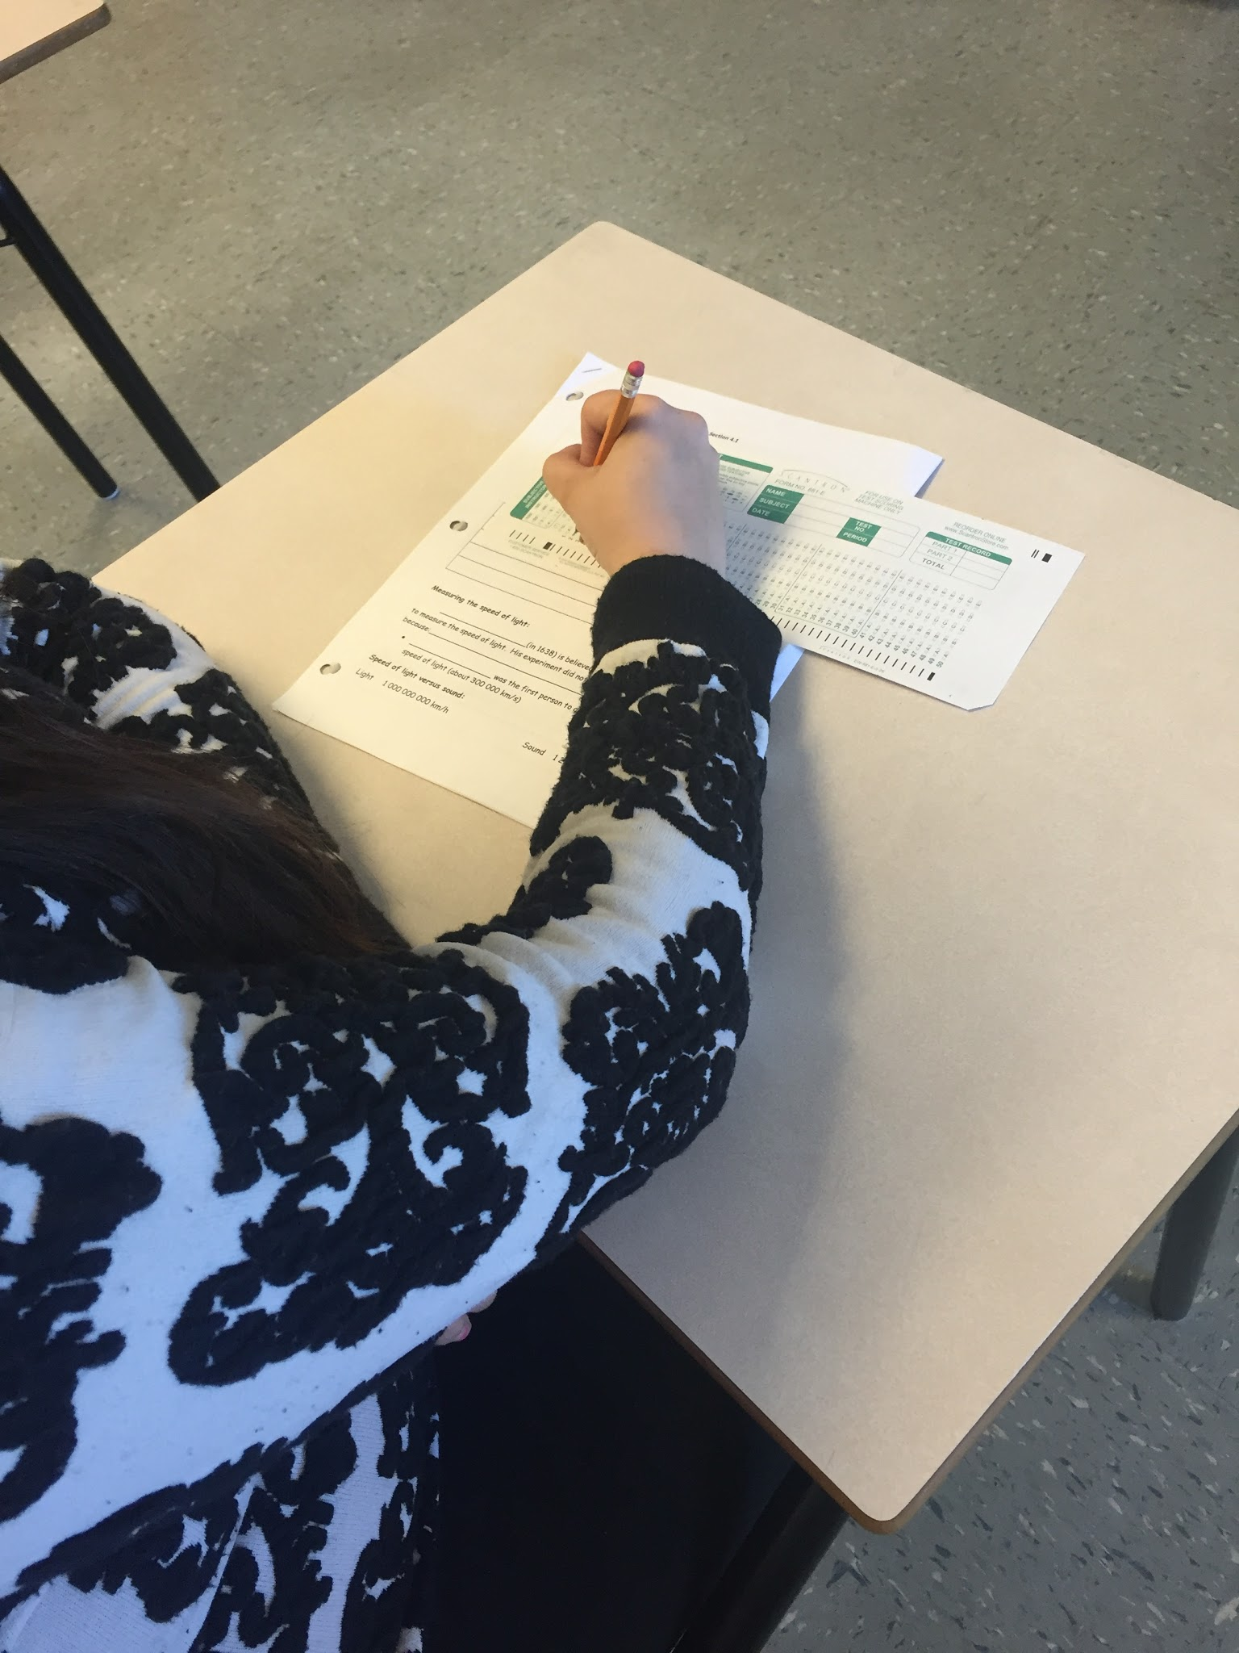
Does inquiry-based instruction support a testing paradigm of pencil and paper tests
Notes:
While our research questions remained front and center throughout the project there were more questions that evolved from inquiry instruction that made us question the value and probably reach a deeper understanding of the pedagogy inherent in inquiry and its value in teaching and learning. Does inquiry-based instruction support our testing paradigm of pencil and pencil quizzes/tests? Does the extended activities deepen understanding at the expense of meeting all the curriculum requirements? Could we change testing to include more performance-based hands-on activities? Are the students enjoying the activities but not taking away deeper learning? Will the project-based component of our research, aquaponics, appeal to a wide range of students or just the students who see themselves as ‘science stars’?
We did consider these questions but always returned to our goal as science teachers to develop thinkers, improve questioning techniques, help students explore their world rather than memorize facts. Believing that inquiry-based learning helps learners and modifying testing techniques to include more performance-based testing was a better solution than the status quo. Students have to engage to learn and if the activities and the testing relate to that exploration and support the learning then motivation will increase. Students who see relevance and construct their science as part of their activities will be more motivated to learn. The initial but unstated part of the question may have been “what do teachers do to enhance motivation through inquiry-based learning” but really became “what does everyone do to enhance motivation through inquiry-based learning?”

Slide 21
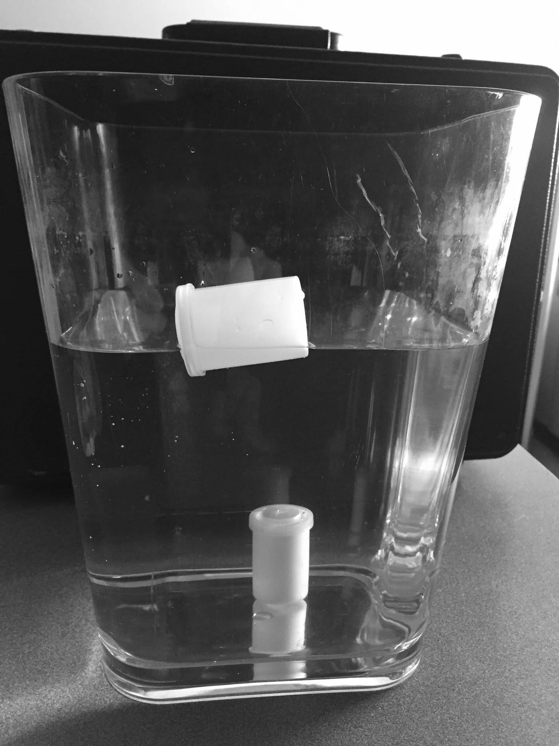
Could we change our testing to a more hands-on performance-based evaluation?

Slide 22
Do extended activities deepen understanding at the expense of meeting curriculum requirements?

Slide 23
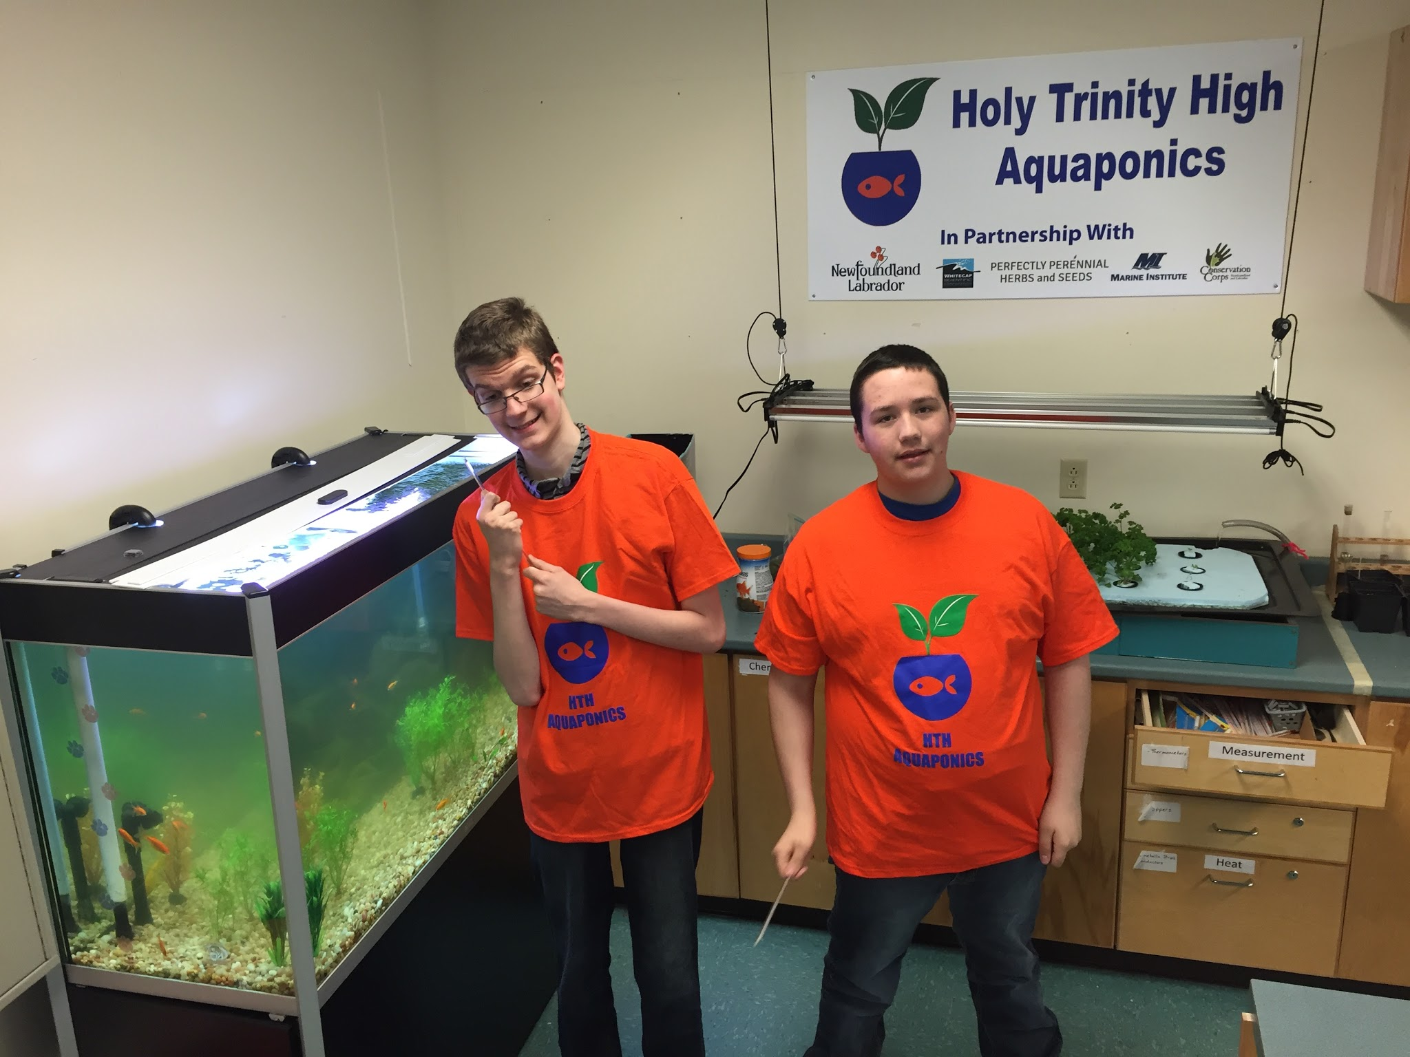
Will the project-based component of our research - aquaponics - appeal to a wide range of students or just the students who see themselves as ‘science stars’?

Slide 24
How do you make inquiry student-centered?

Slide 25
Ethical Considerations

Slide 26
Introductions and communication
Curriculum night
Consent forms
Personal websites,
Google Classroom
Twitter @sciencemercer , @HTHaquaponics, @GlennNormore,
https://twitter.com/hthaquaponics
Notes:
During our curriculum night at school in September we introduced parents to our plans and distributed consent forms to our parents. On our personal websites, Google Classroom and through Twitter we shared pictures and videos of students daily activities and learning. @sciencemercer , @HTHaquaponics, @GlennNormore, Students and parents enjoyed seeing videos of themselves/their children explaining things they had learned.

Slide 27
Introductions and communication
Students and parents enjoyed seeing videos of themselves/their children explaining things they had learned.

Slide 28
Permissions
Permissions forms
A parent information letter and consent
Notes:
Permissions forms were sent home for parents to sign, giving consent for their child to be interviewed and video recorded for Memorial University. A parent information letter and consent form was sent home to be signed giving permission for teachers to document students and their work.

Slide 29
Planning

Slide 30
Planning Activities
Thomas Walsh and Karen Goodnough
Articles and websites
Discussions
Experiences and backgrounds throughout our careers.
Notes:
Mr.Thomas Walsh and Karen Goodnough to discuss our plan. They guided us through the planning and implementation process. We were provided articles and websites to visit and see how others have taken on such tasks. Discussions to ensure we met curriculum outcomes. Through our discussions we each had ideas and activities to share that we have experienced throughout our careers. Each of us have different backgrounds and experiences, these experiences allowed us to create

Slide 31
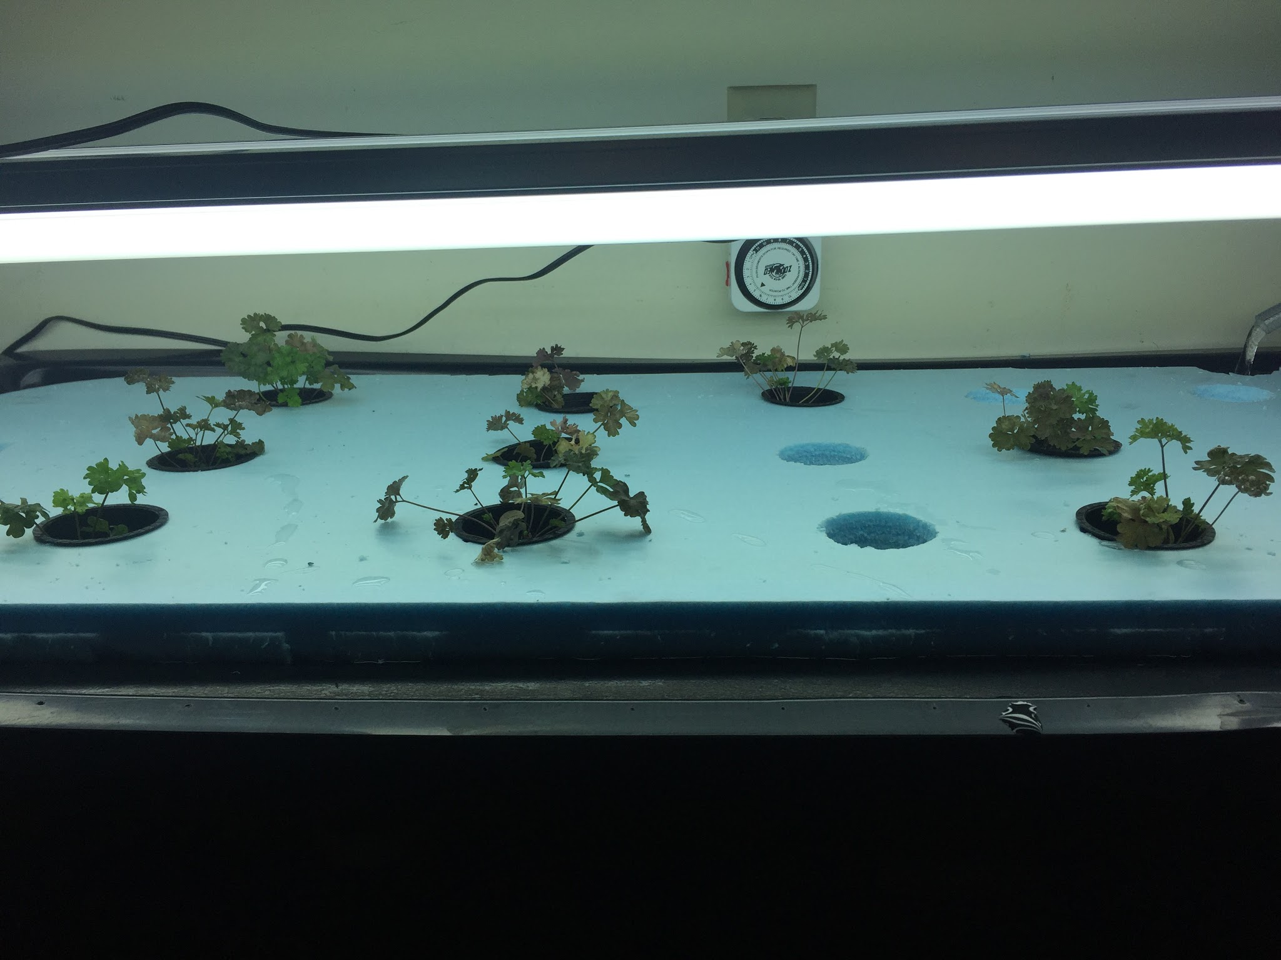
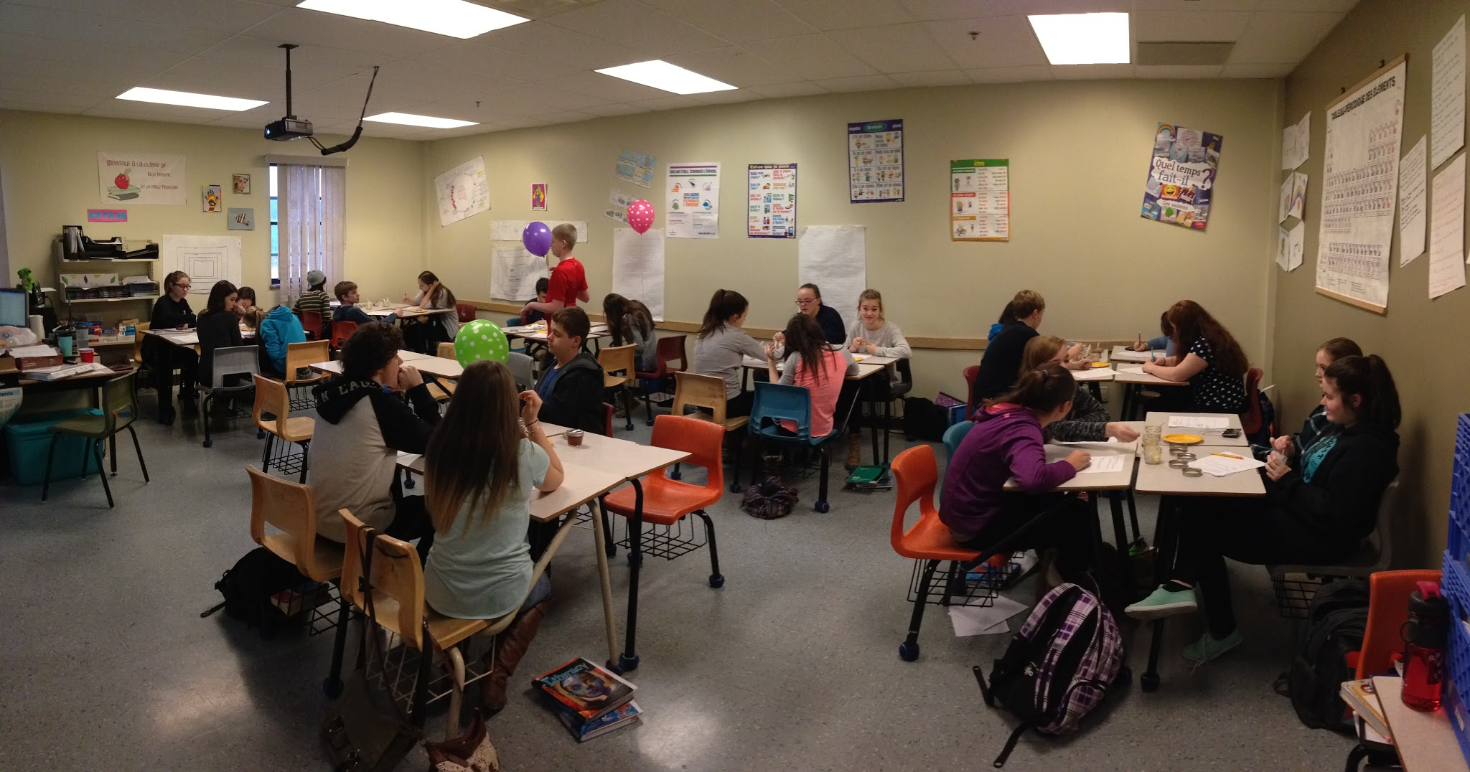
Literature guidance
Planning and implementation.
New ways of teaching and learning.
Notes:
Guided us in our planning and implementation. Through our research and reading we discovered new ways of teaching and learning that other educators have tried in their classes.

Slide 32
“Students’ motivation in learning science was enhanced if the teacher made science concepts related to daily life, provided hands-on activities for students to manipulate, and created the opportunities for group discussion on the content” (Tuan et al., 2003, p. 5)

Slide 33
Implementation

Slide 34
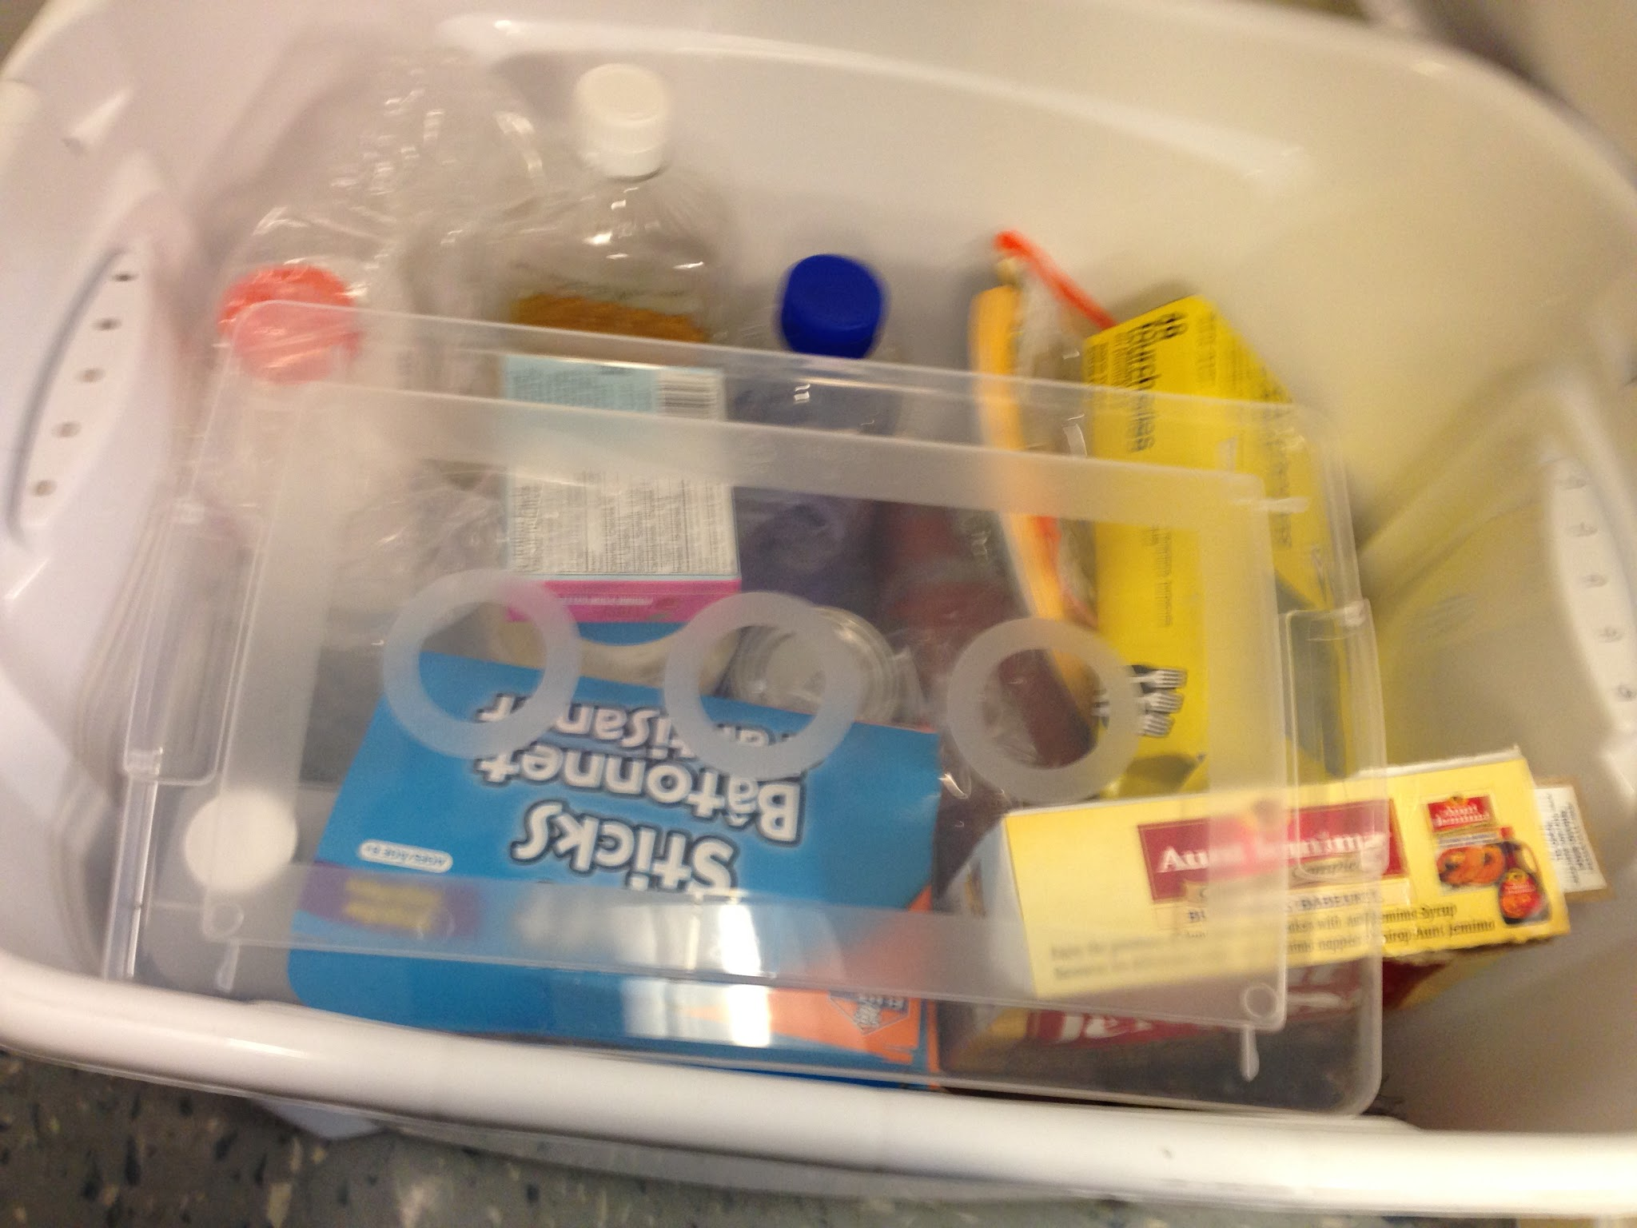
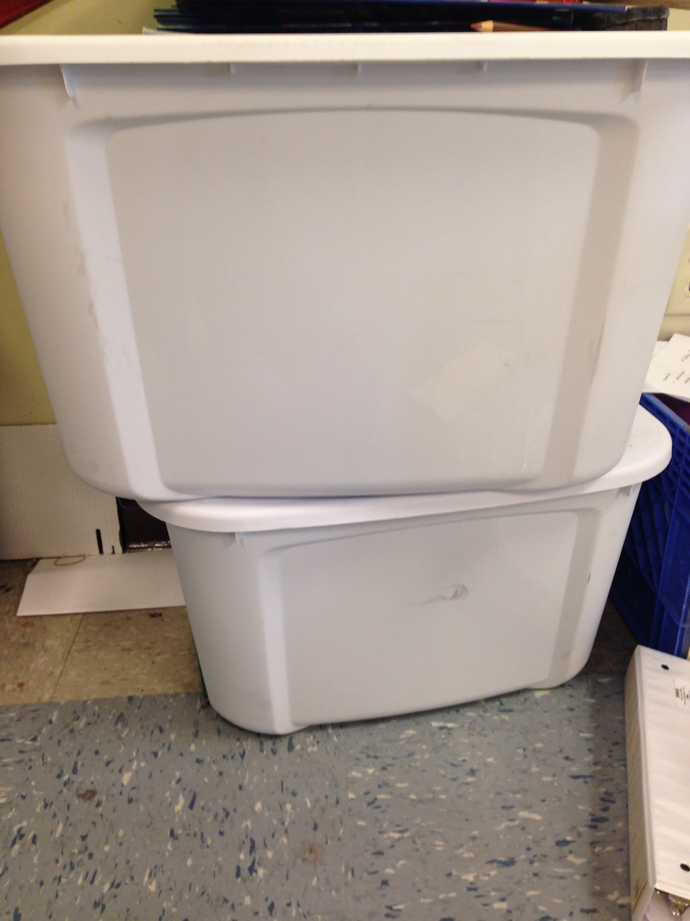
Basic Steps
Provided a probe for our students.
Organized our items for our lessons and created classroom bins
Groups of 3-4
Little direction but worked as a team to explore the topic of the day.
Notes:
To begin lessons we often provided a probe for a student's. Whether it was a question, picture or video to assess prior knowledge and to engage students and get them thinking. Probes helped guide our teaching and student learning. Our TIA team spent some time organizing our items for our lessons and creating our classroom bins to hold our lesson items. When students entered our classroom we would have their lesson kit ready for their groups. Our classrooms were organized into groups of 3-4 (color coded groups - red team, blue team, student choice team). Students quickly learned the routine and would enter class asking which team they were working with today. Most lessons included students being given items to help them discover fluids. They were given little direction but worked as a team to explore the topic of the day.

Slide 35
Activity!
Performance Assessment

Slide 36
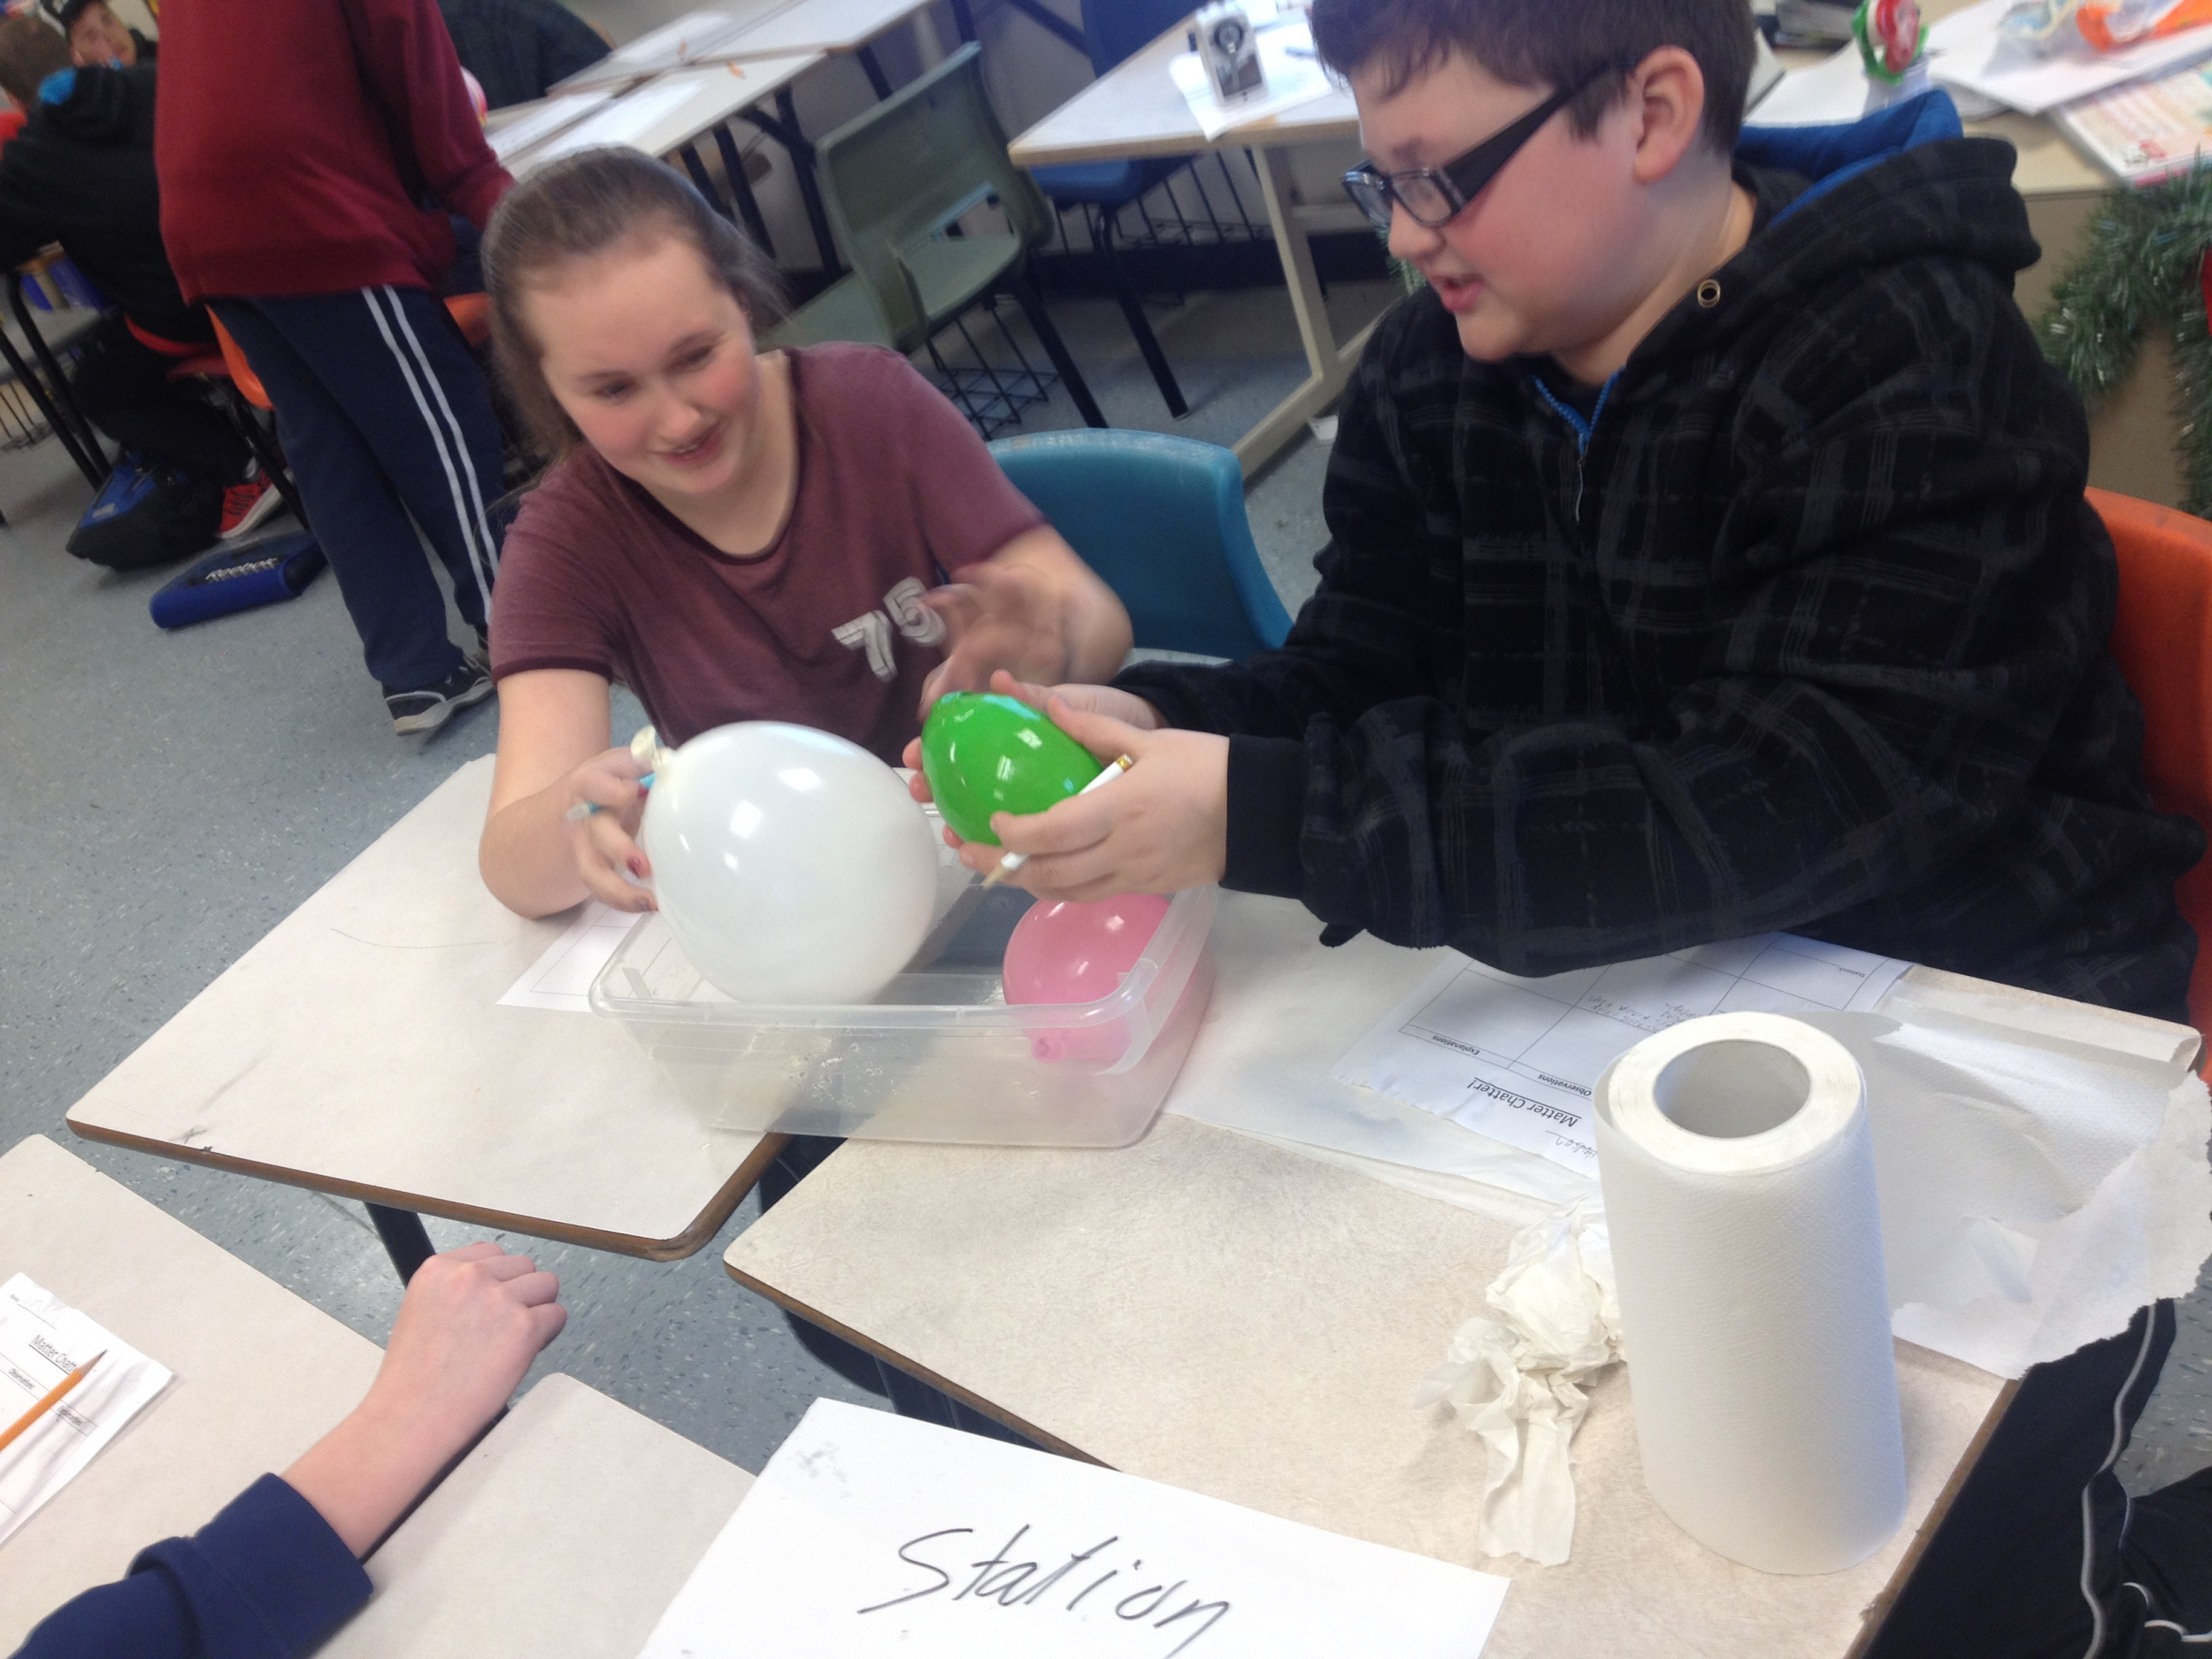
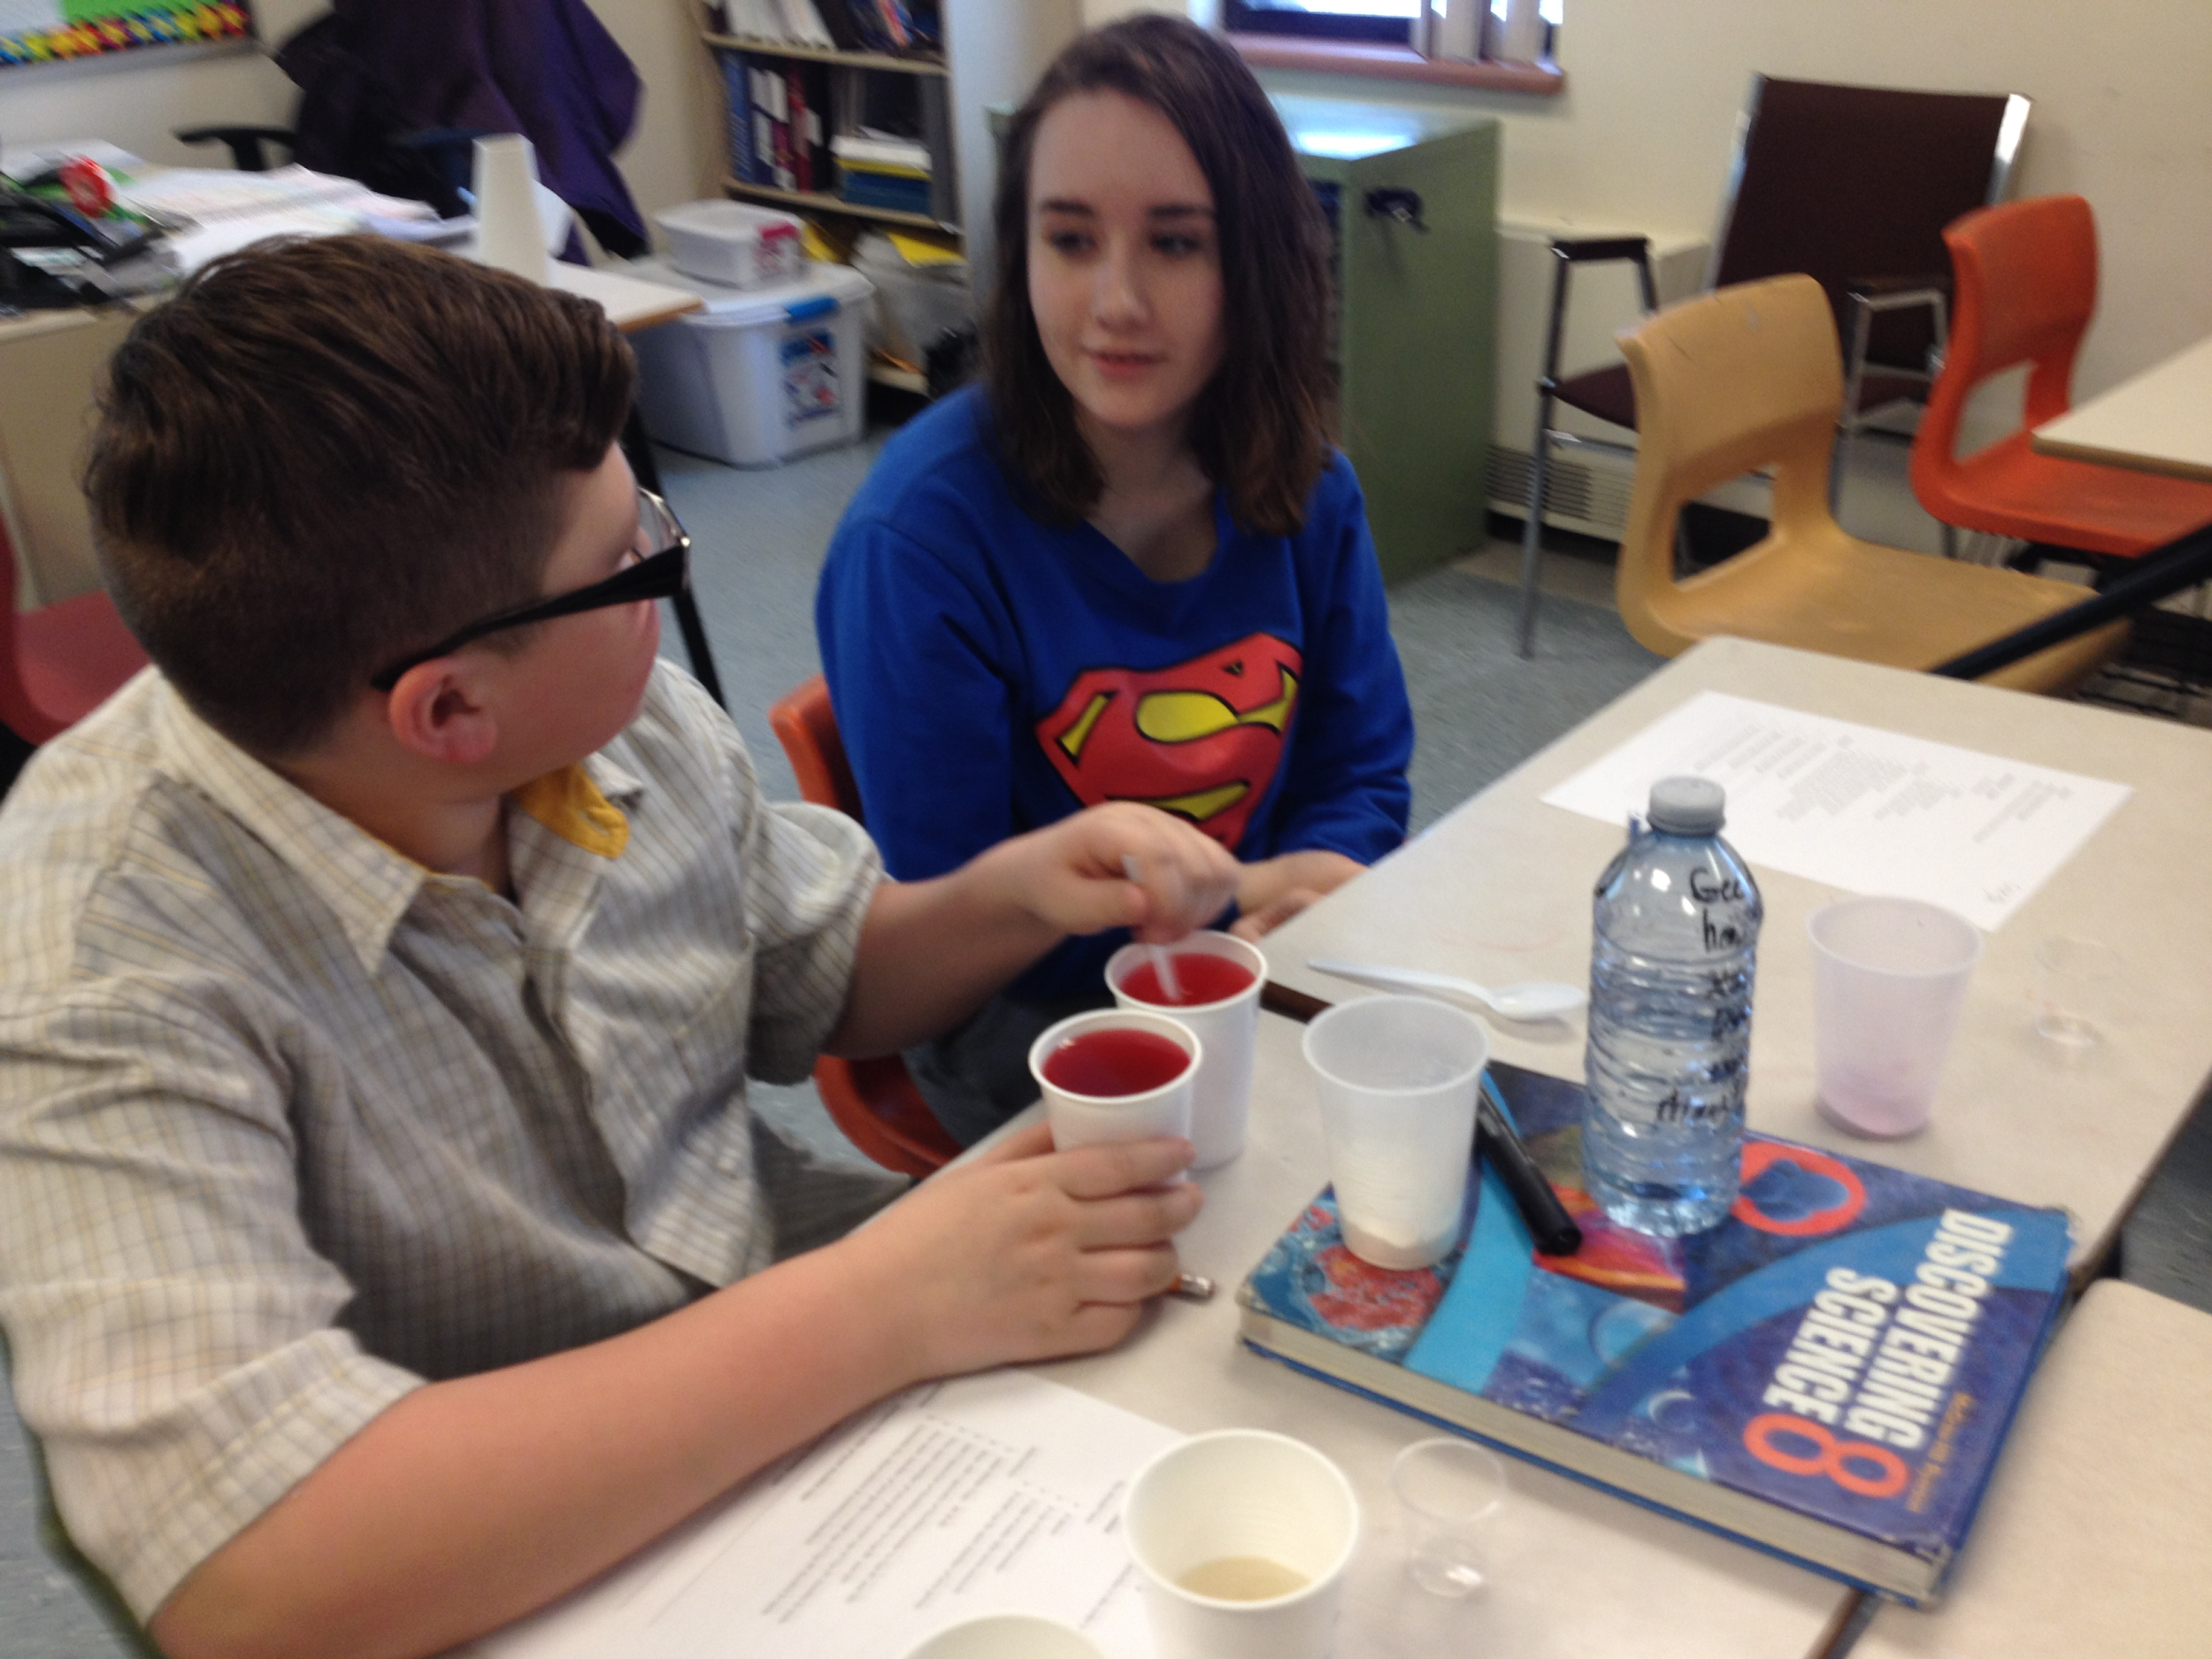
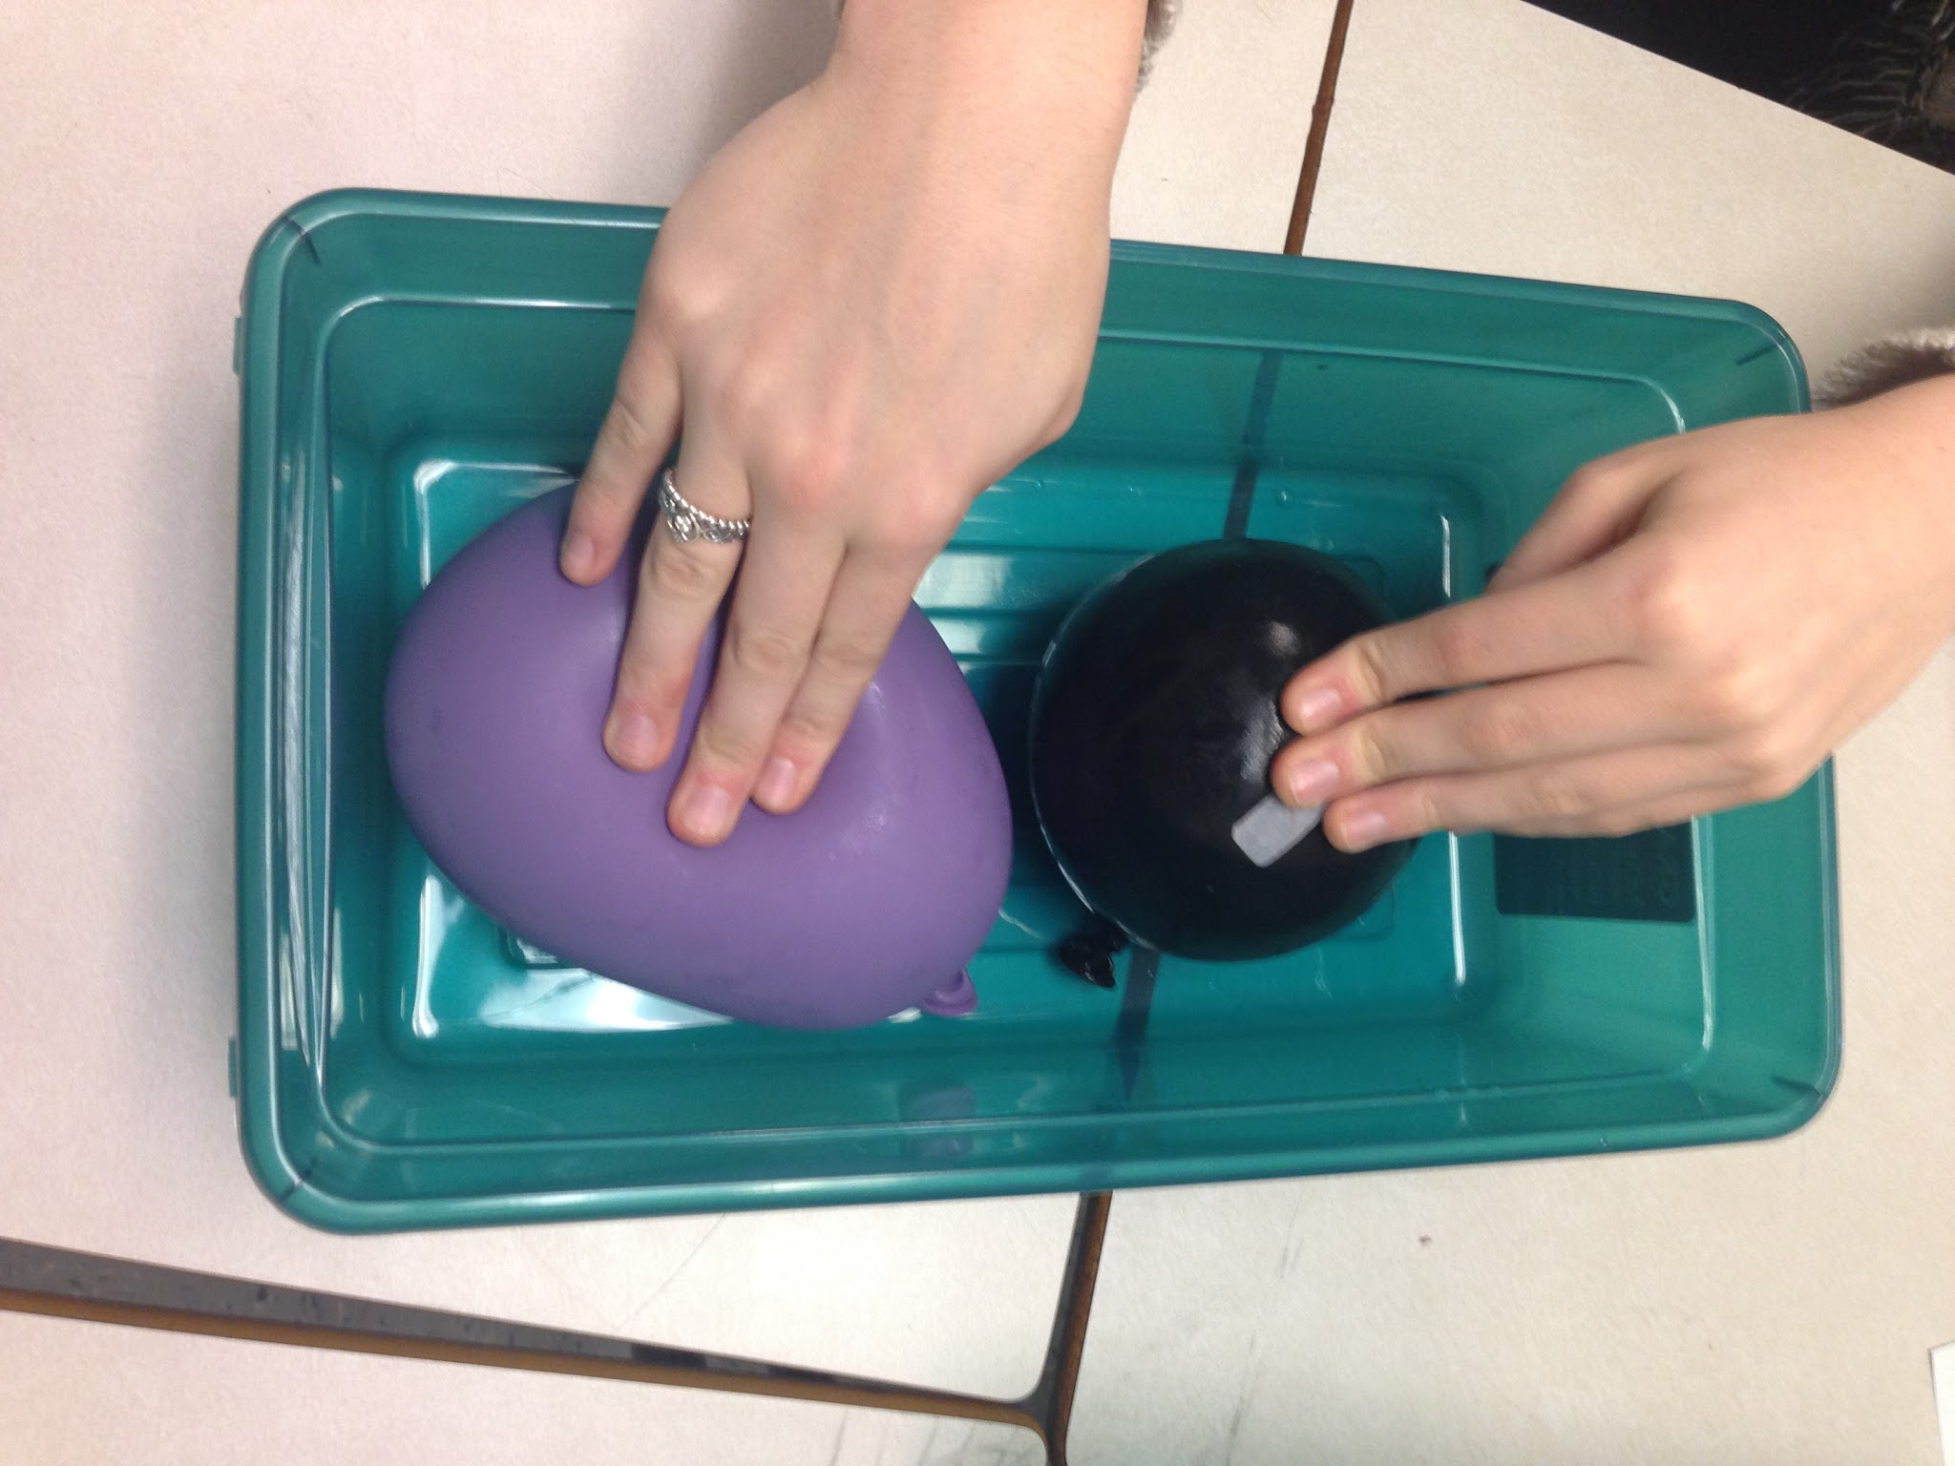
Solids, Liquids and Gases (PTM)

Slide 37
Solids, Liquids and Gases (PTM)

Slide 38
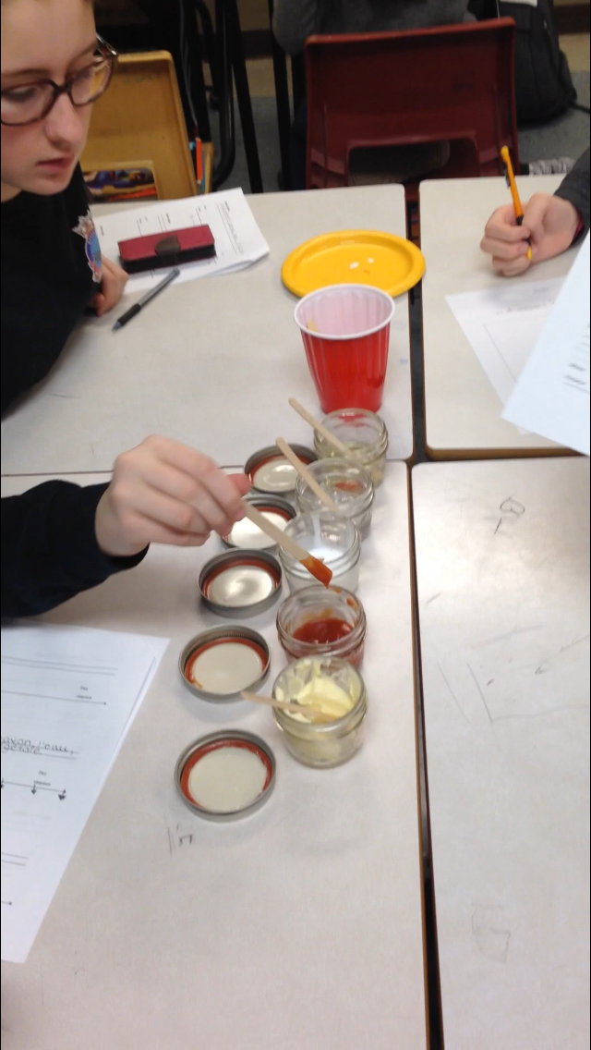
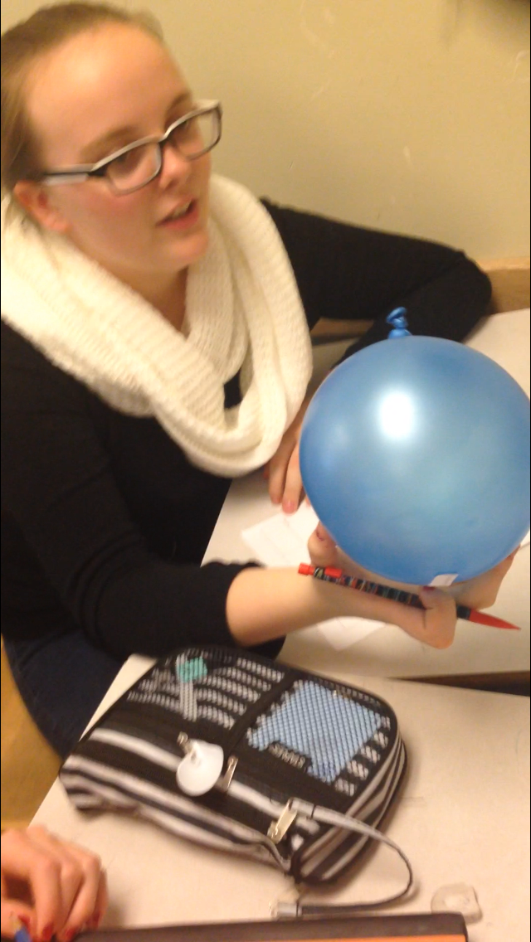
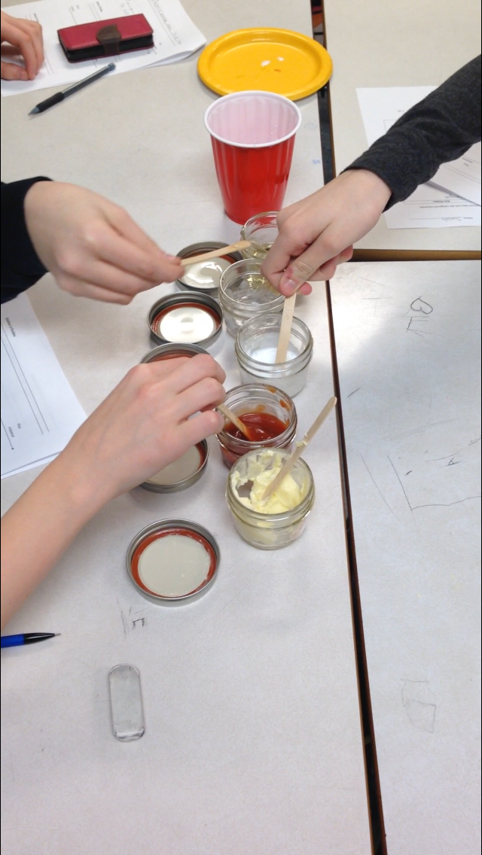
What is a fluid?

Slide 39
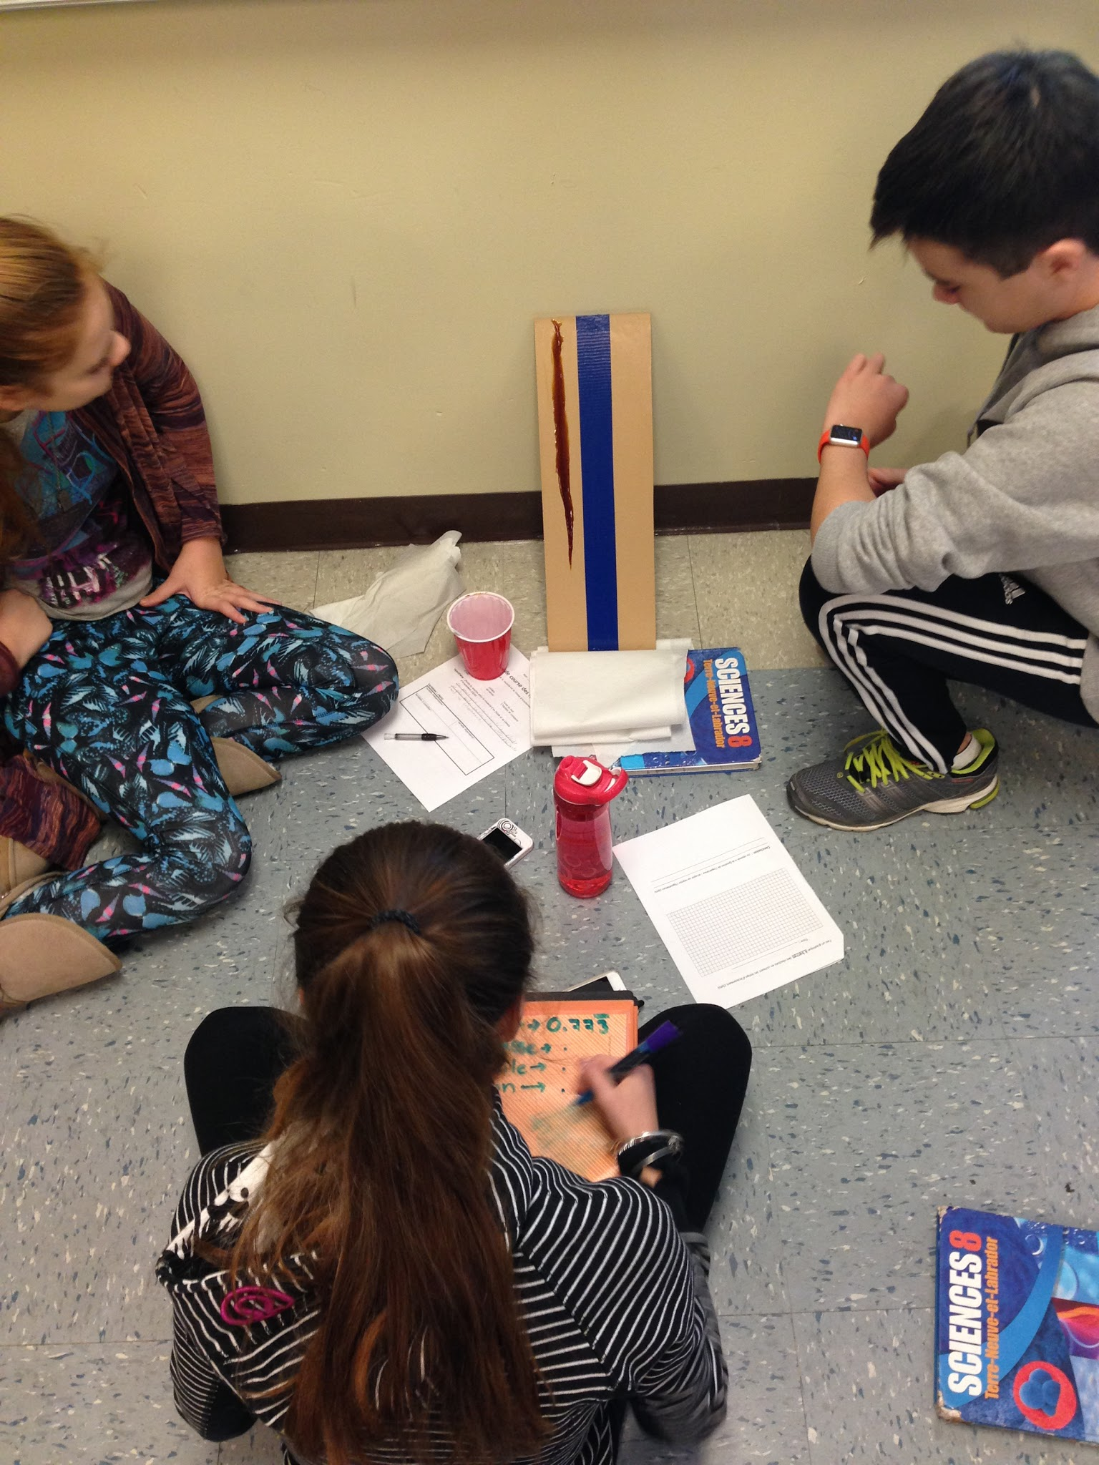
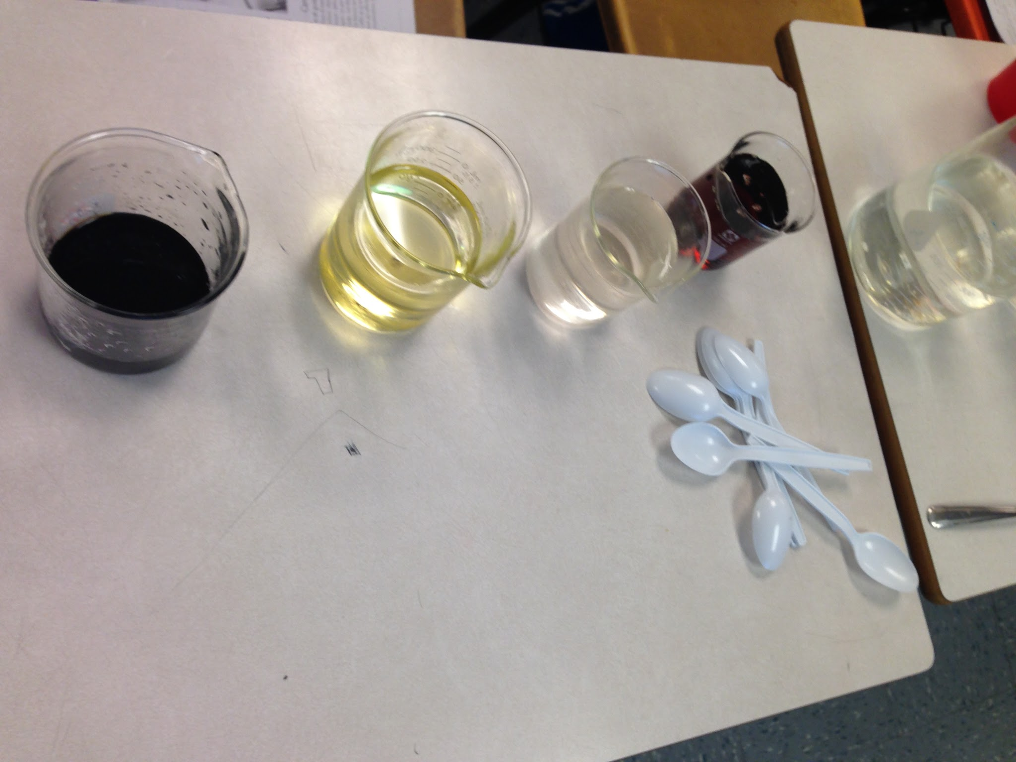
Flow Rate and Viscosity

Slide 40
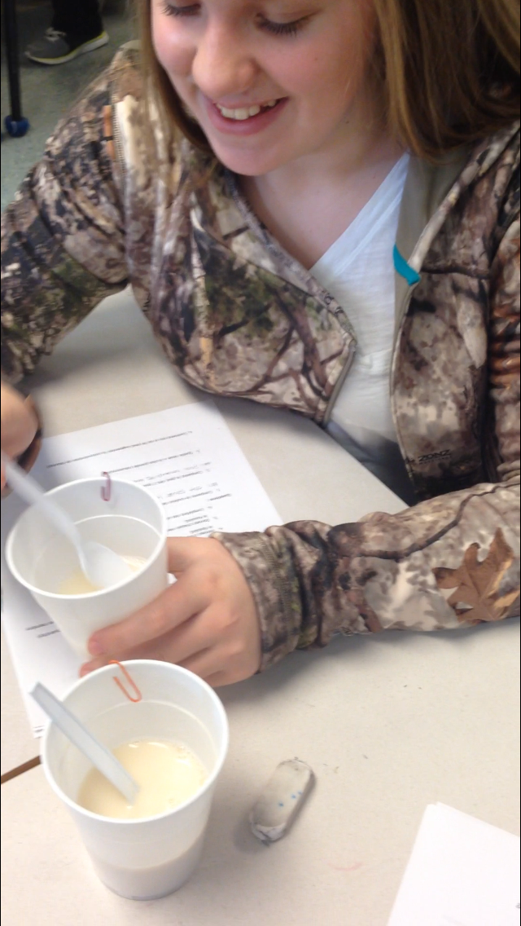
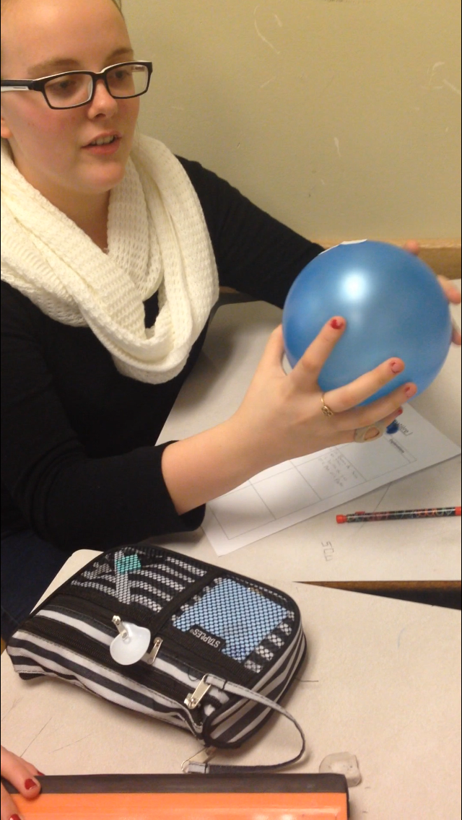
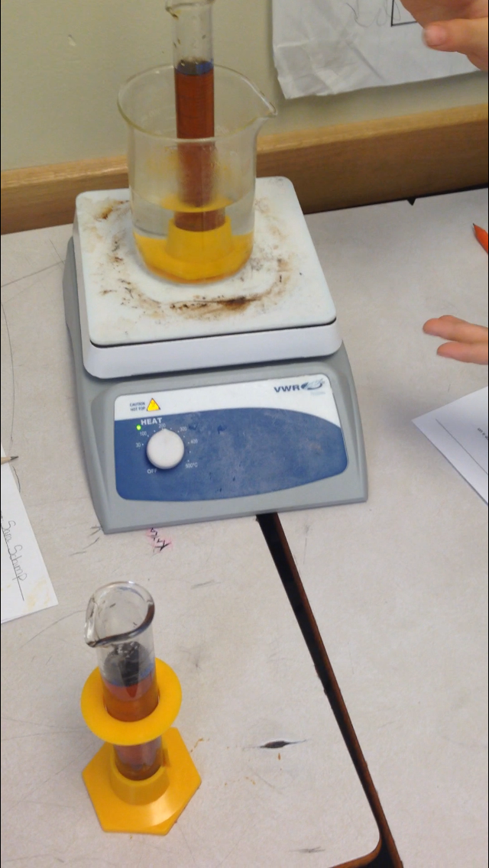
What affects viscosity?

Slide 41
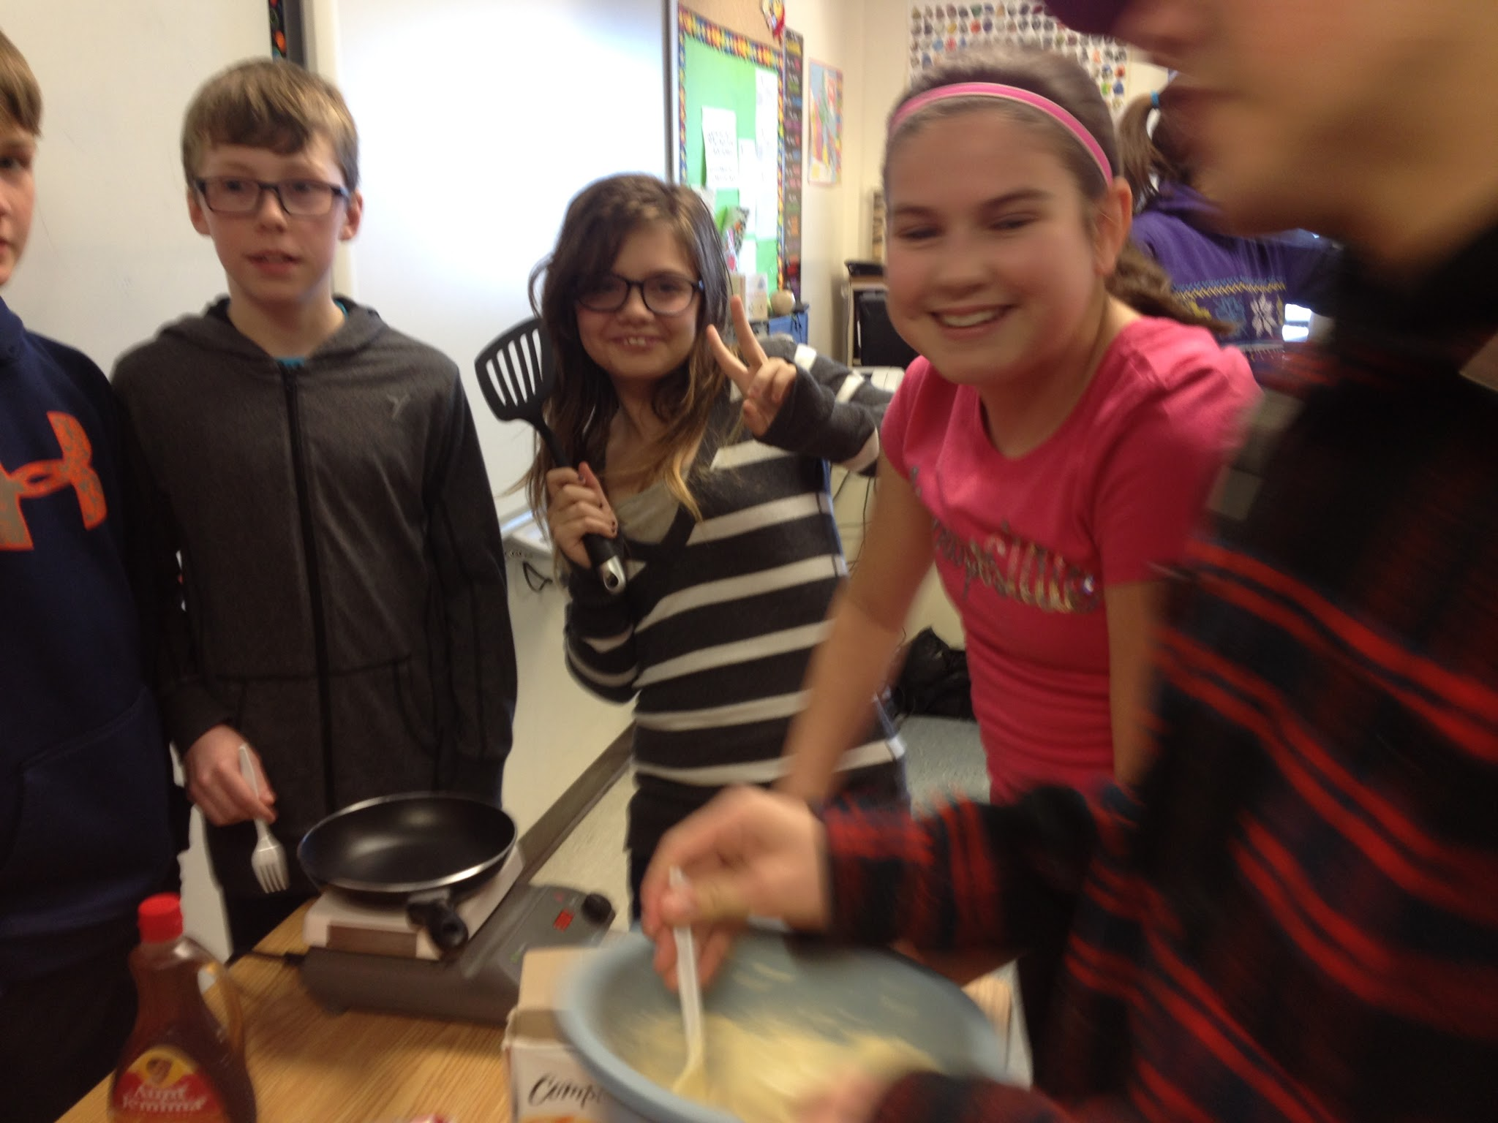
Pancake Celebration!

Slide 42
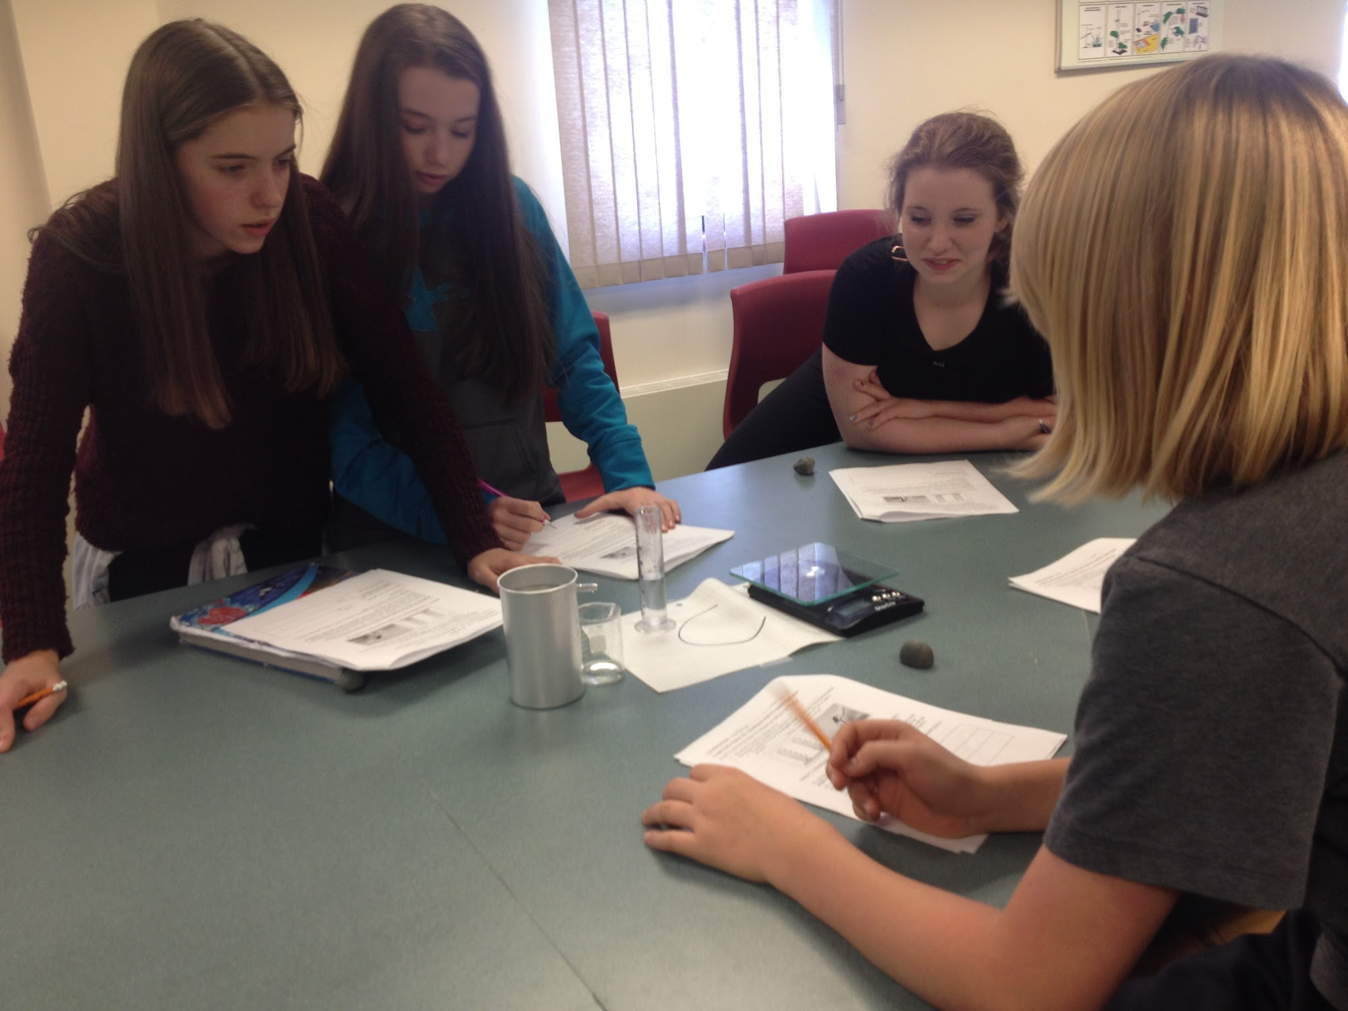
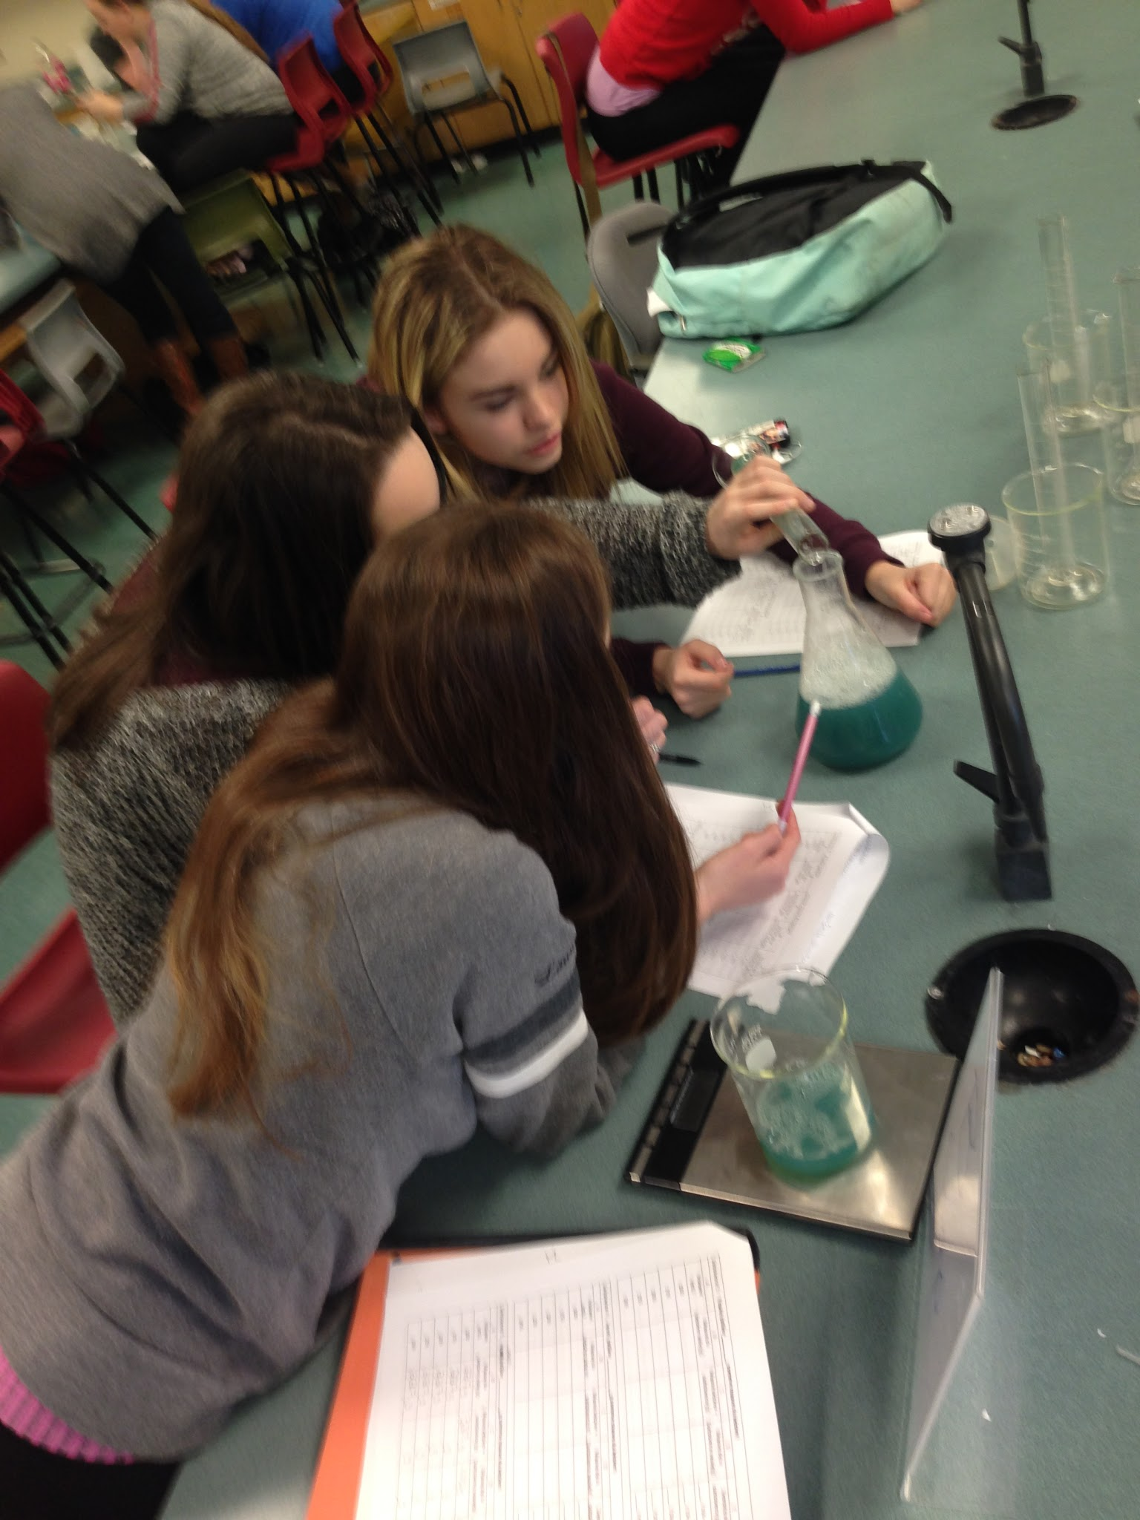
Exploring Density

Slide 43
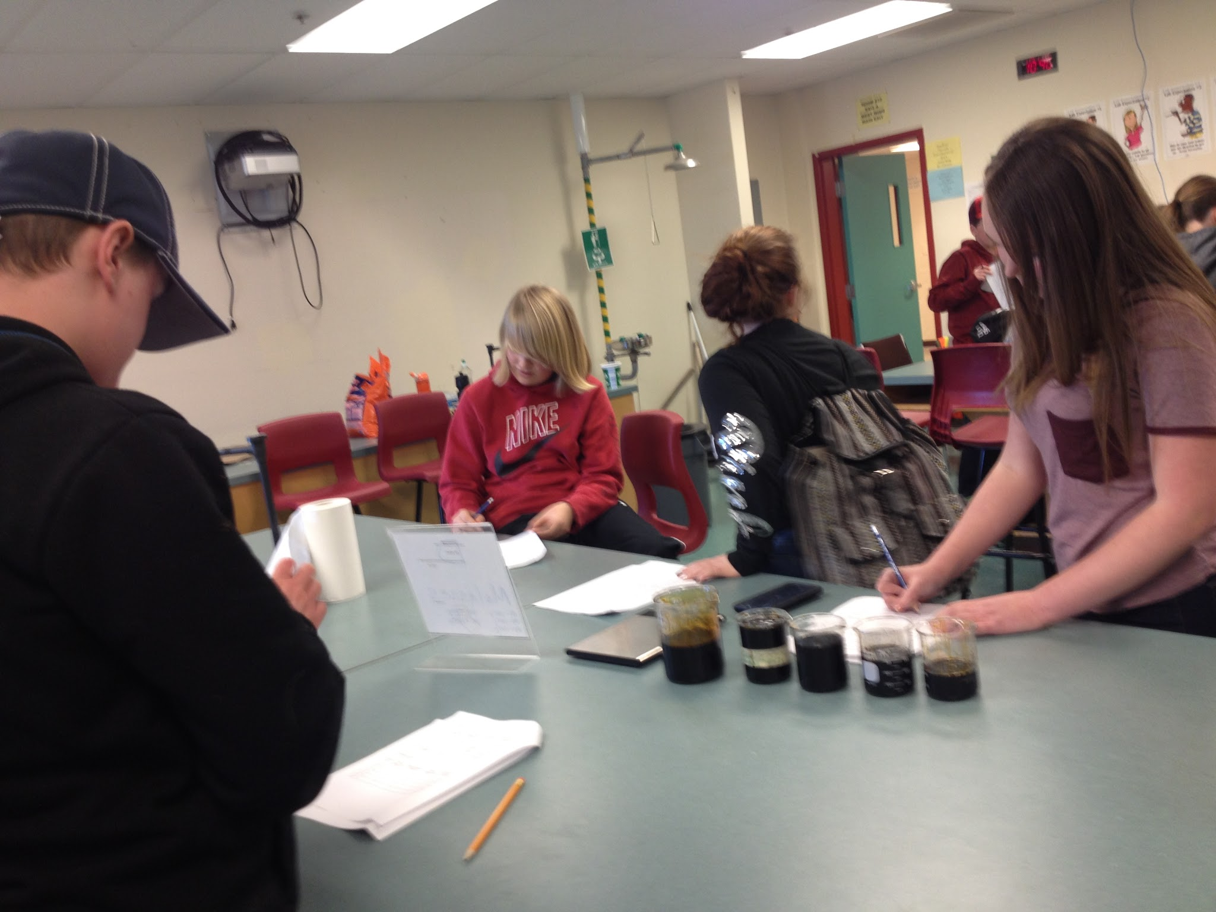
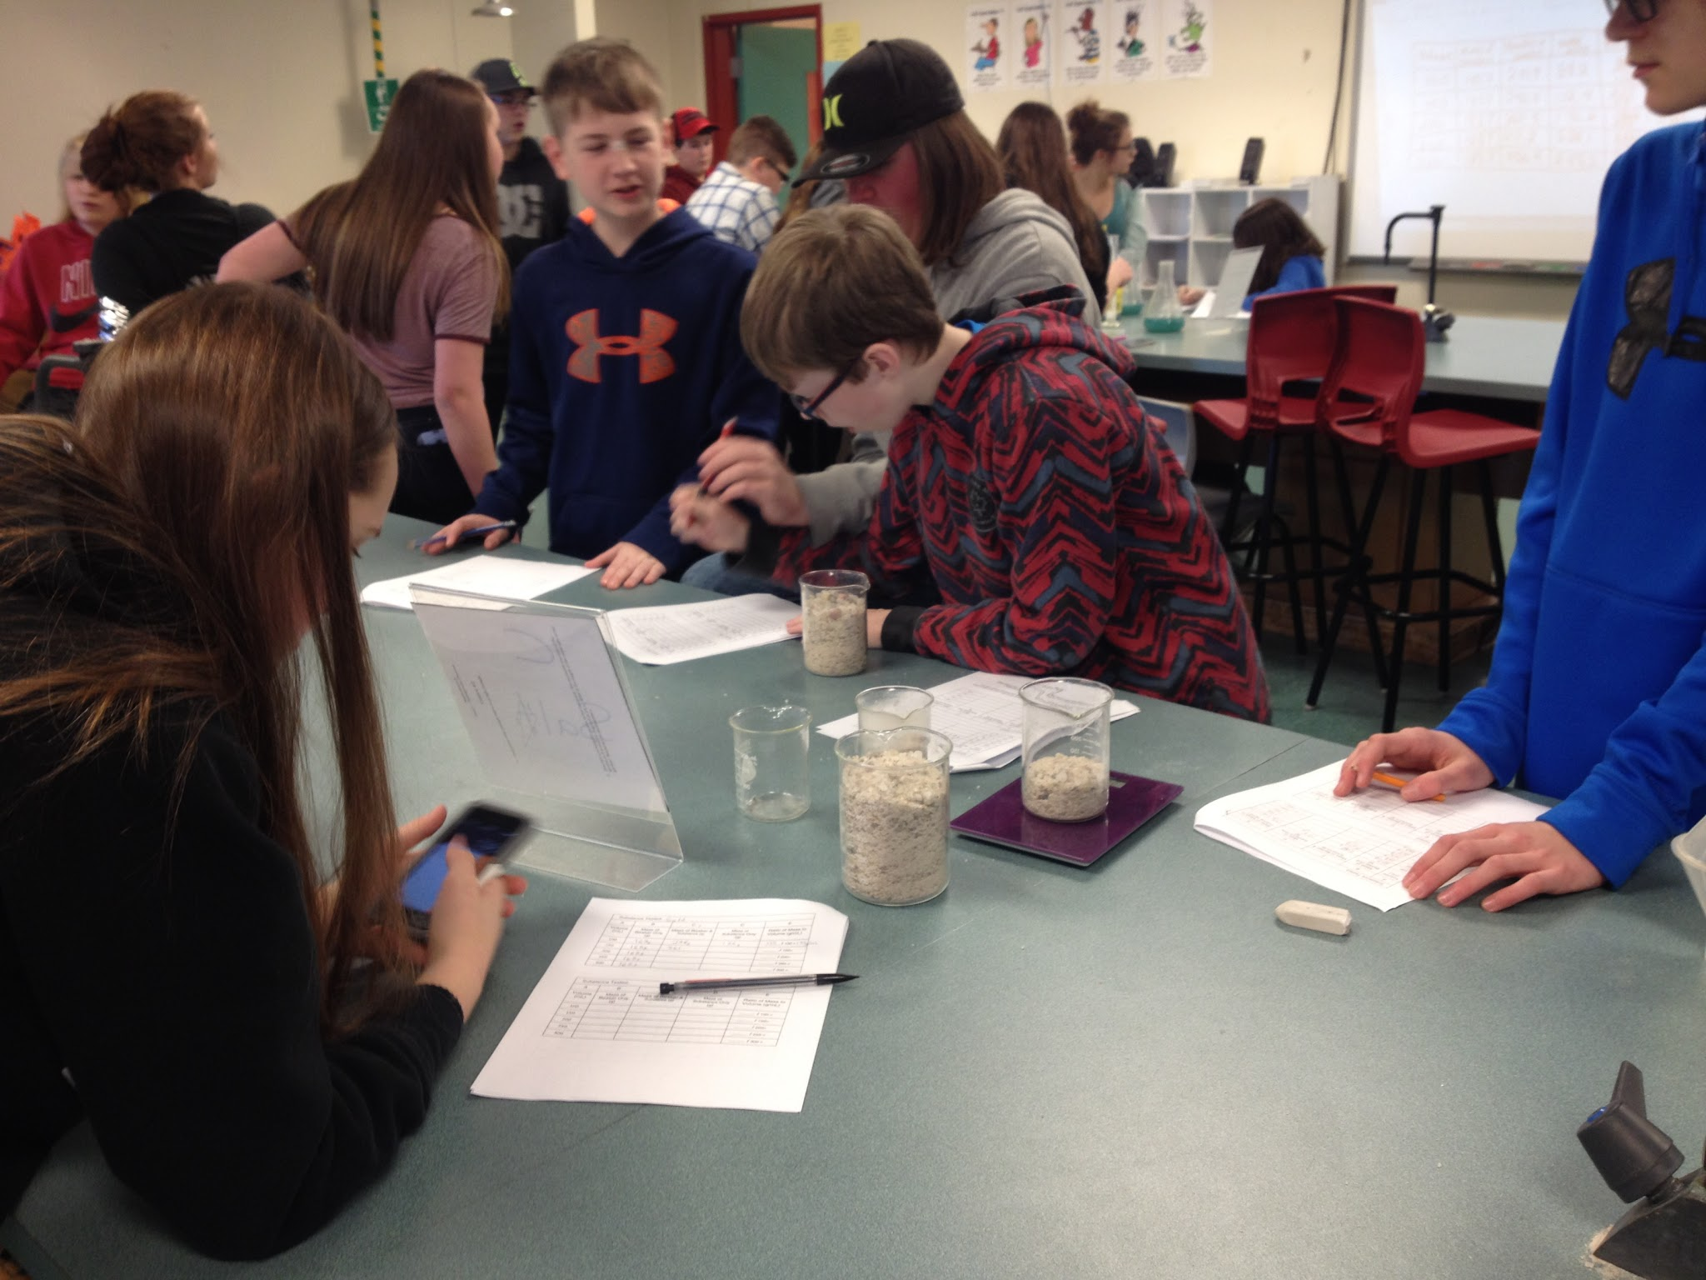
Density Lab!

Slide 44
Balanced and Unbalanced Forces

Slide 45
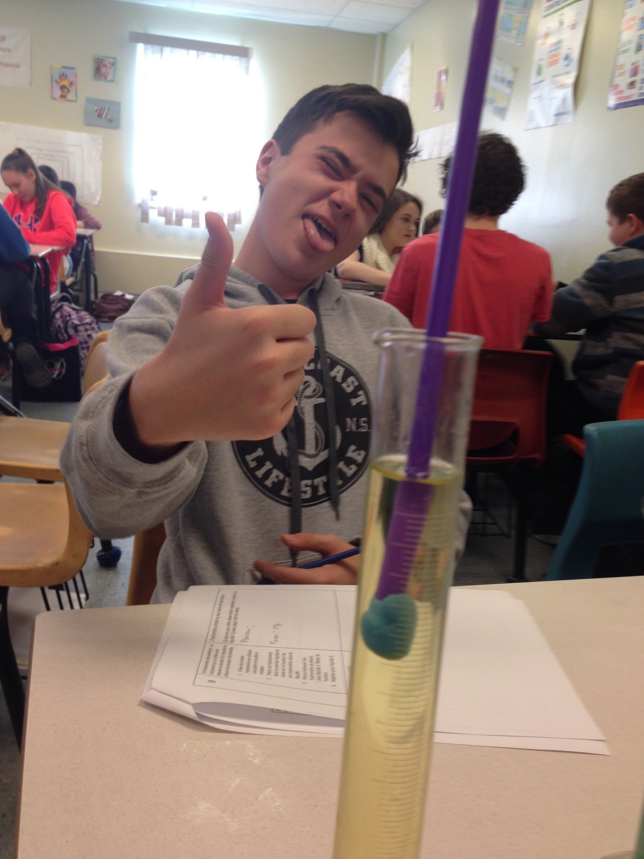
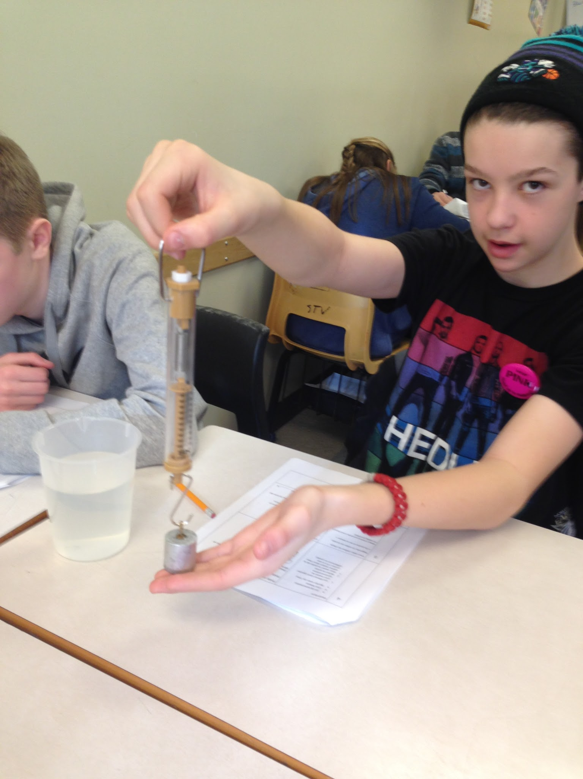
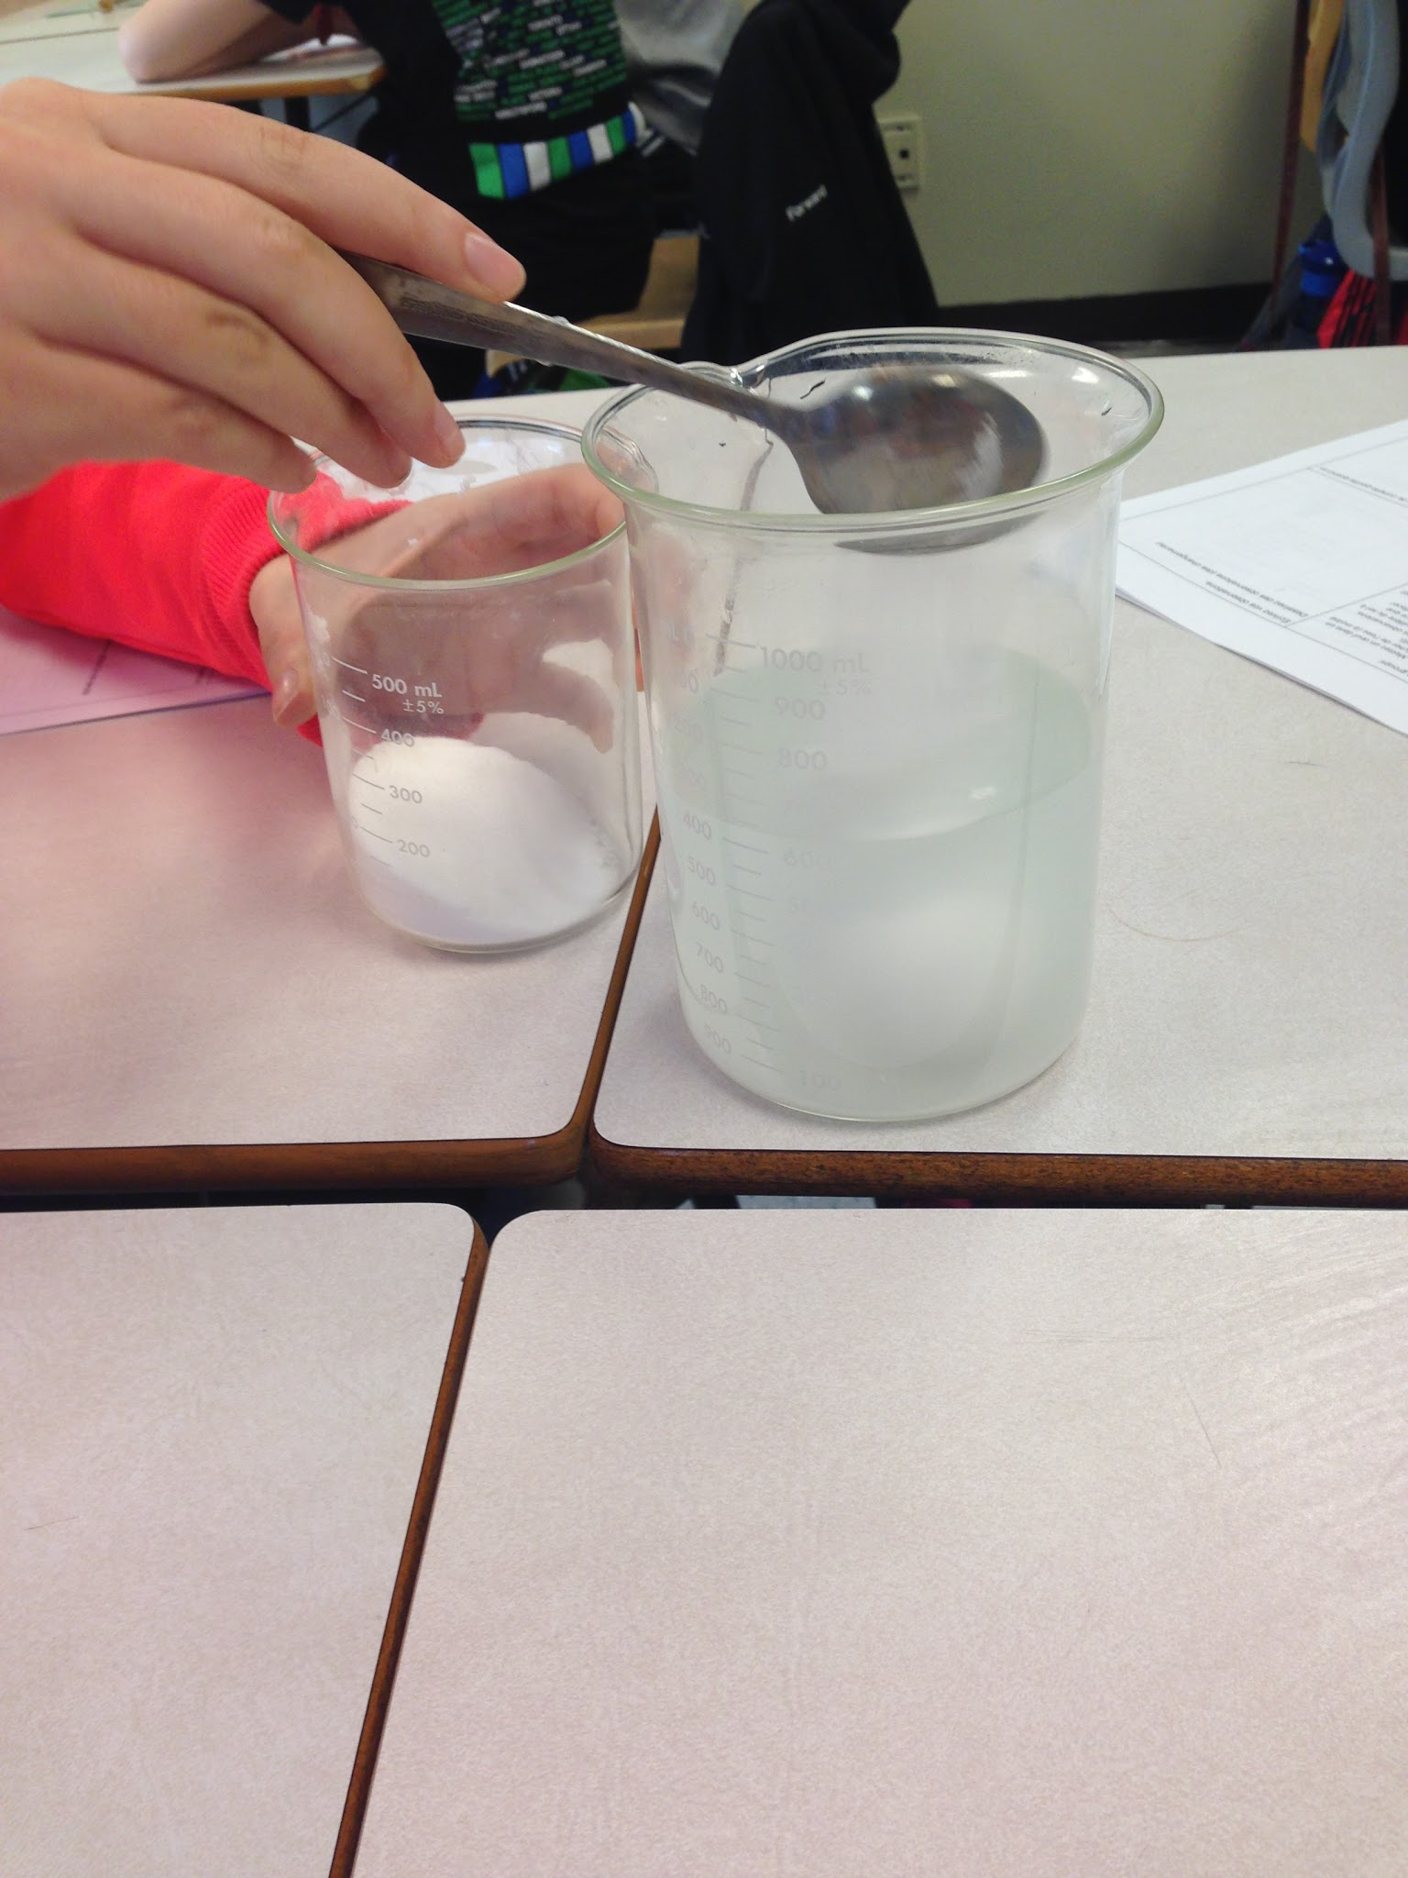
Buoyancy and Applications of buoyancy

Slide 46
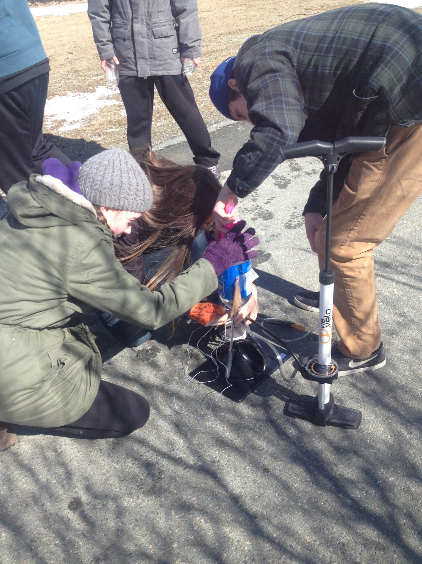
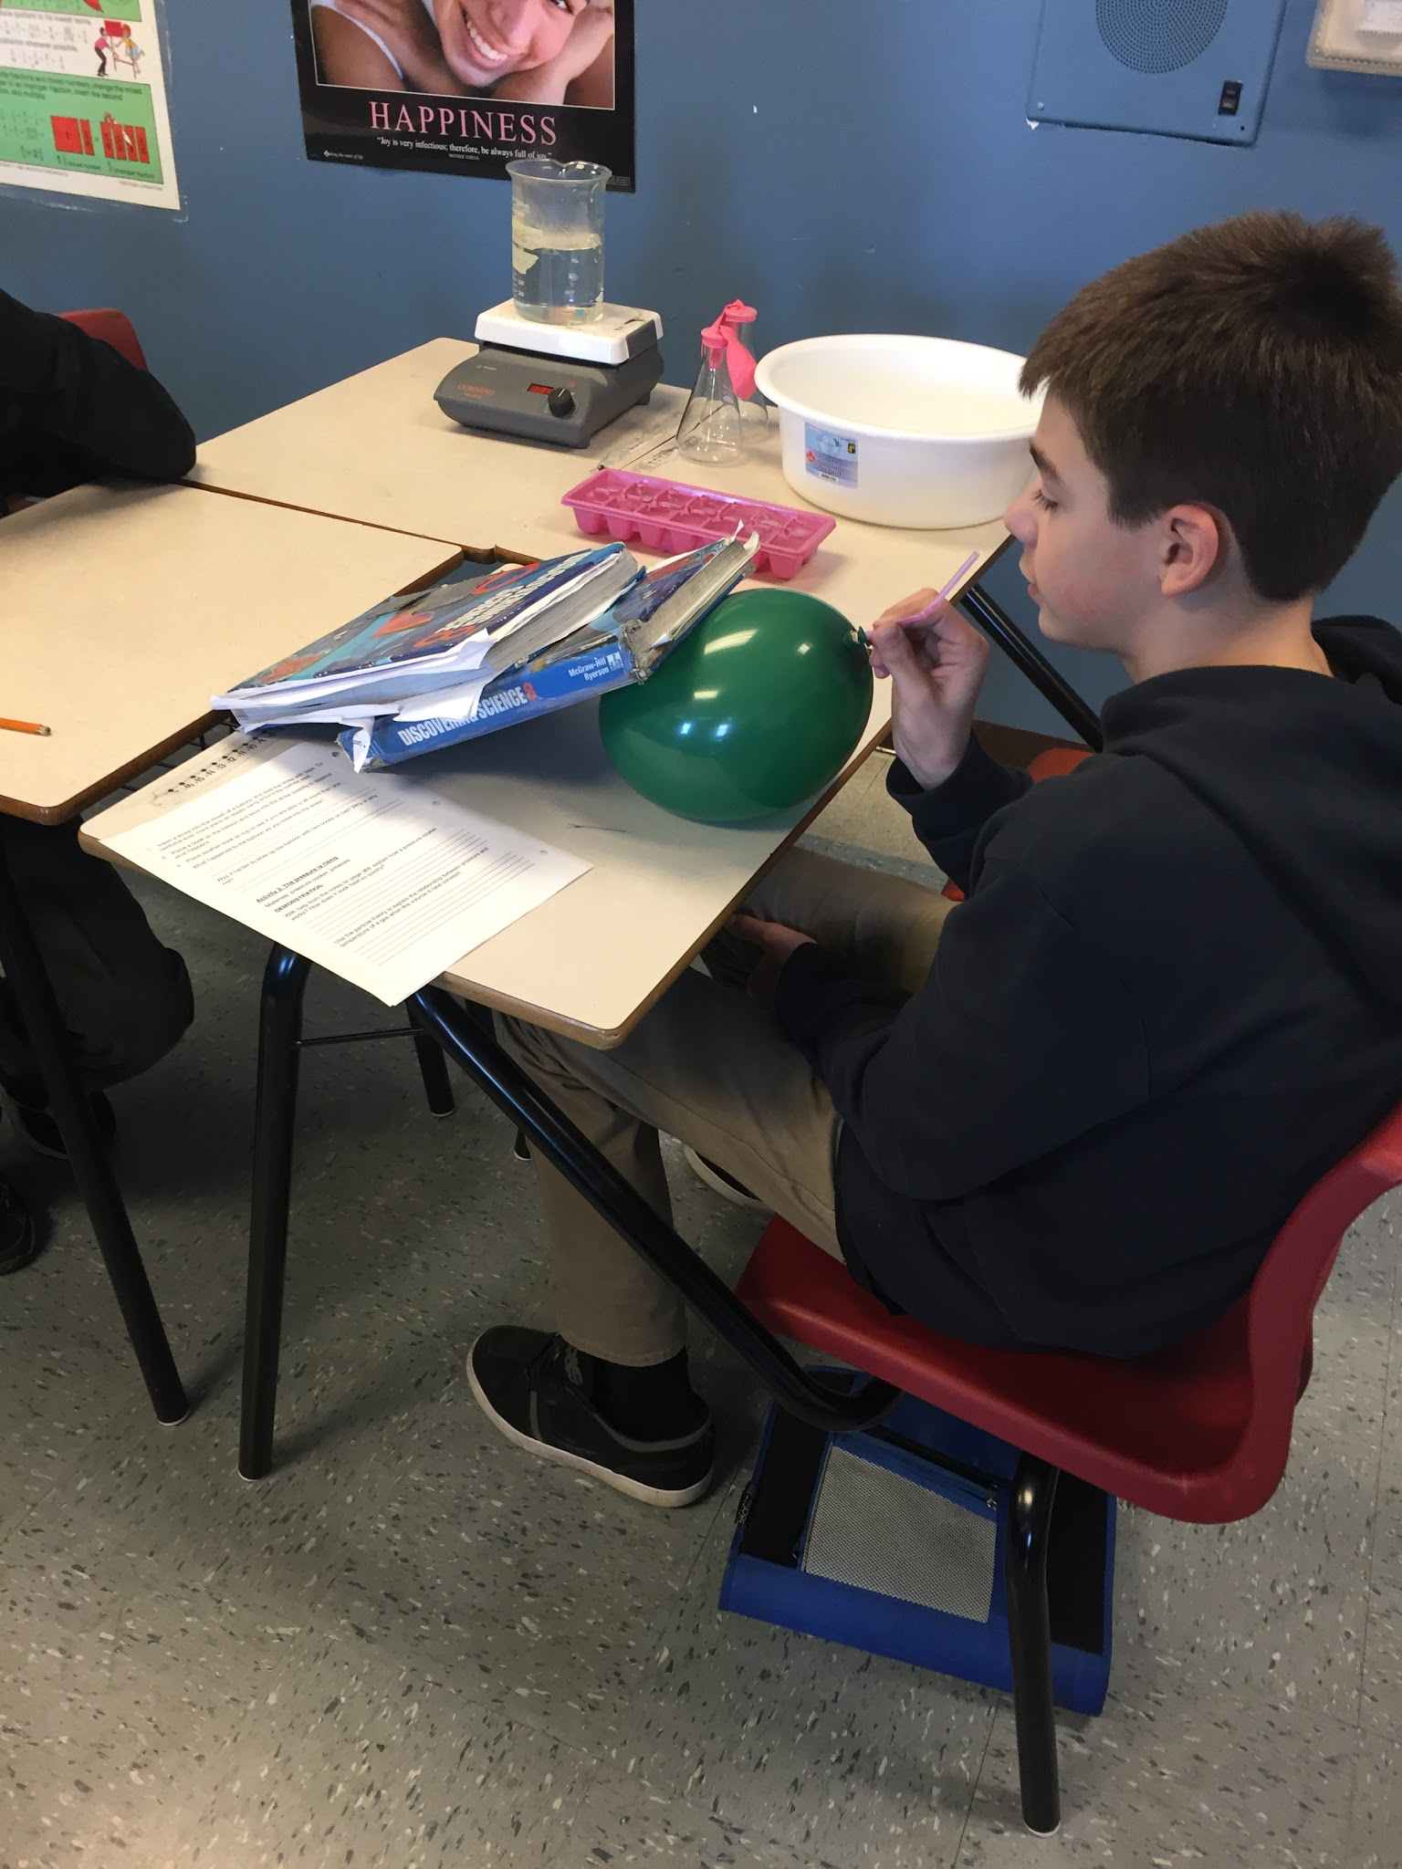
Hydraulic Systems

Slide 47
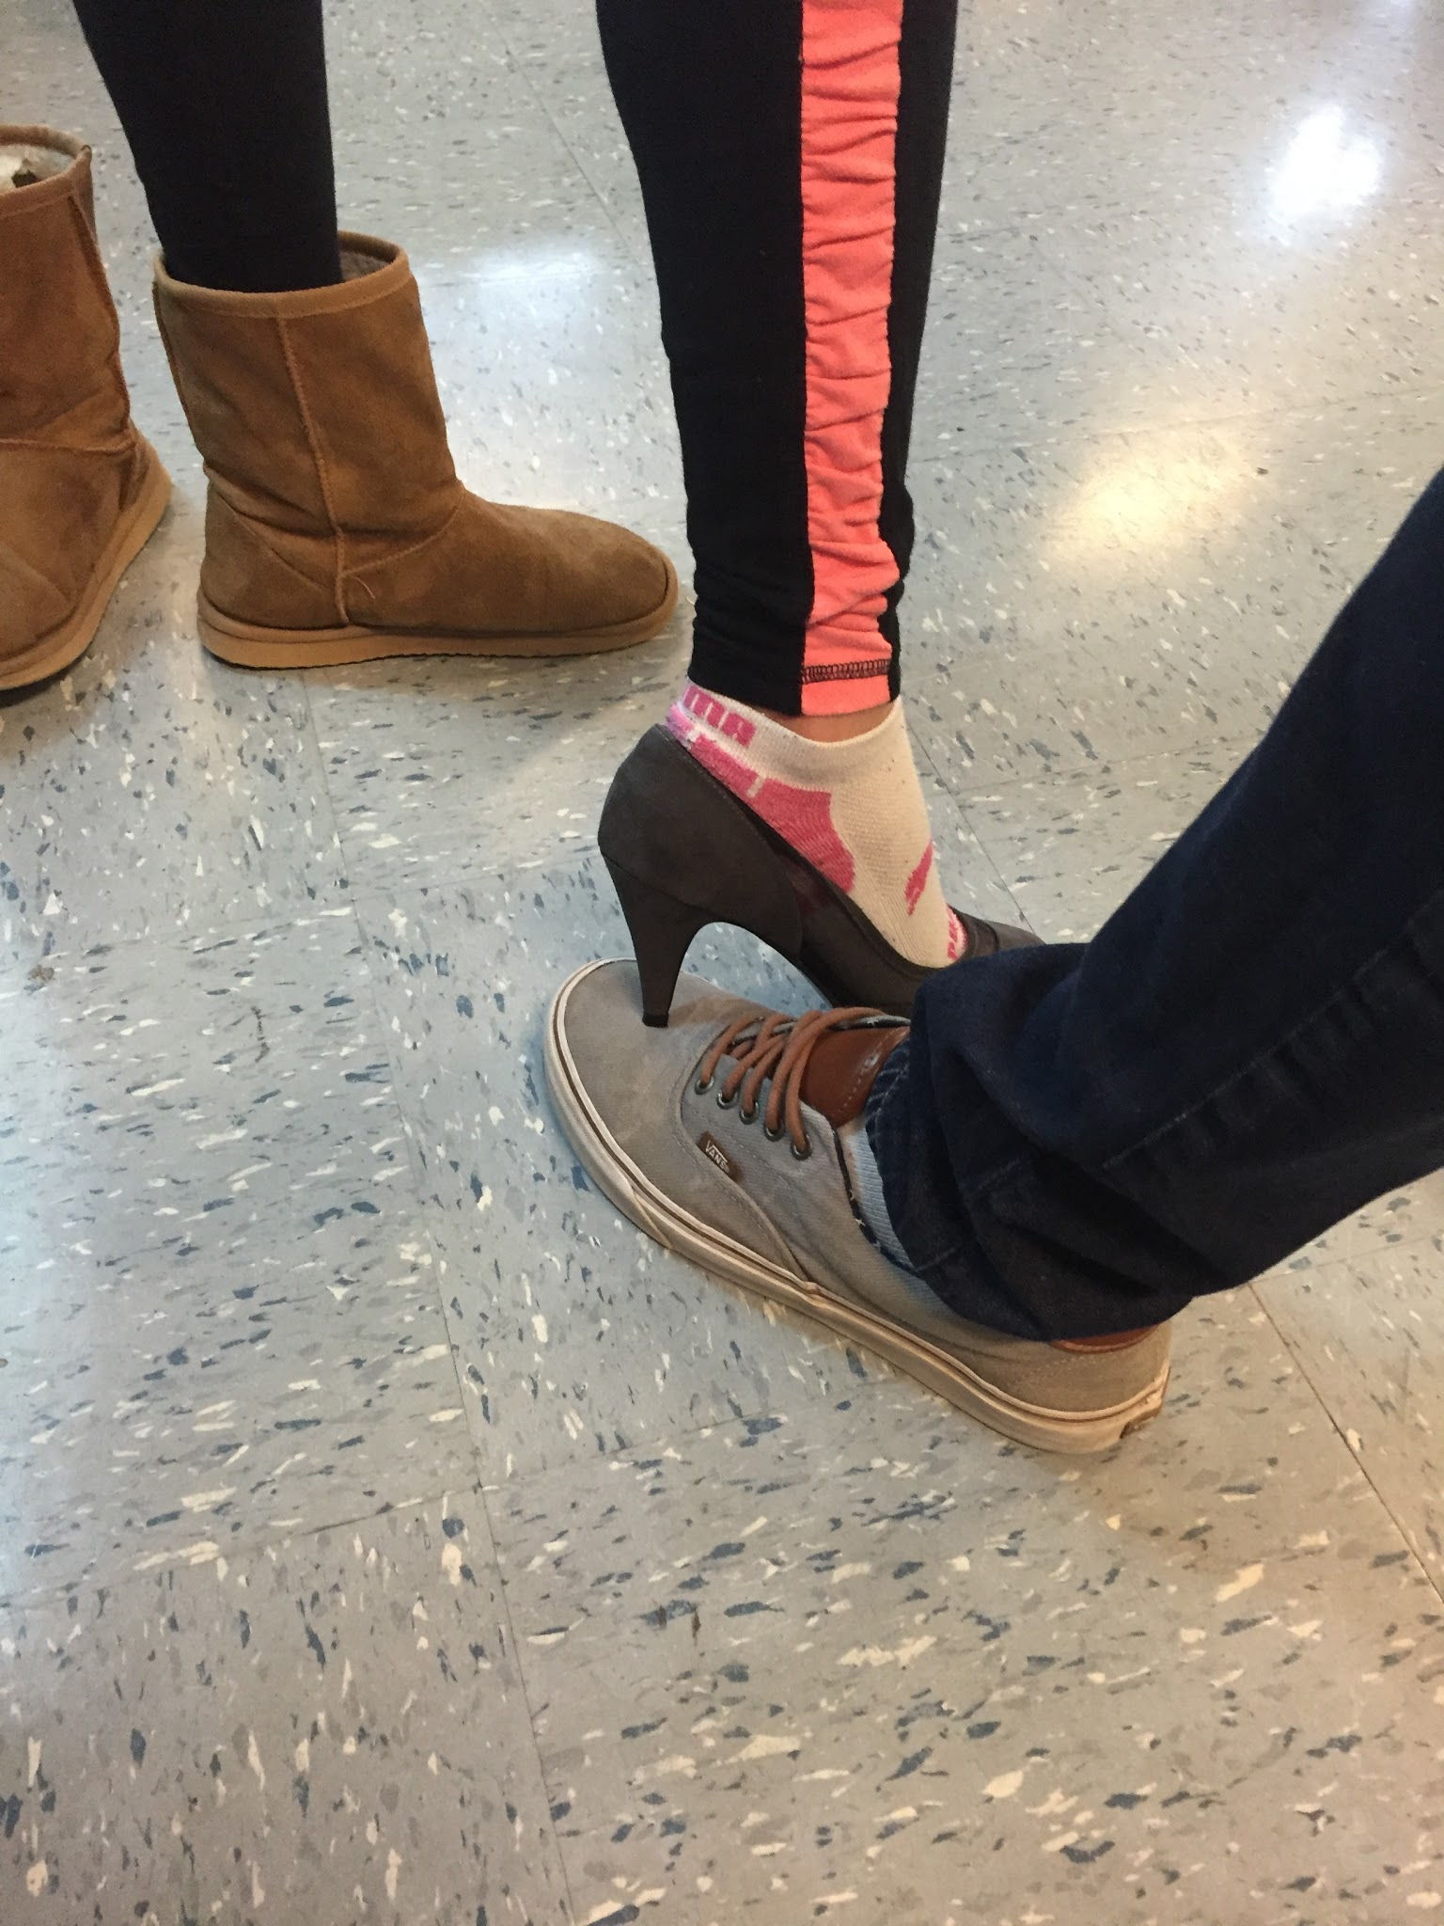
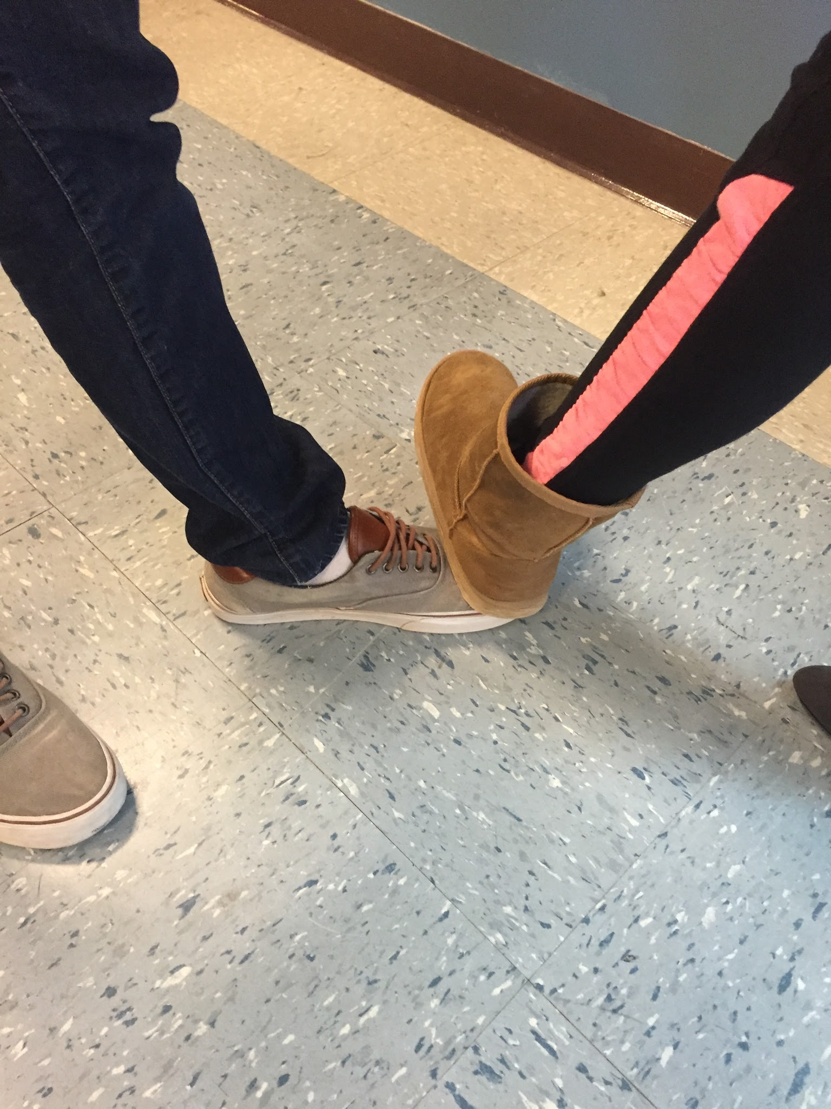
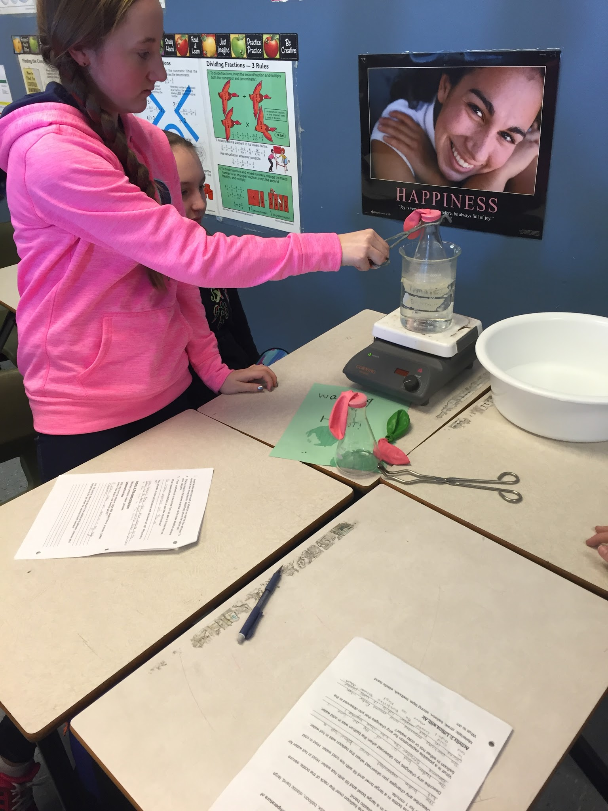
Relationship of Pressure, Volume and Temperature

Slide 48
Rocket Launch!

Slide 49
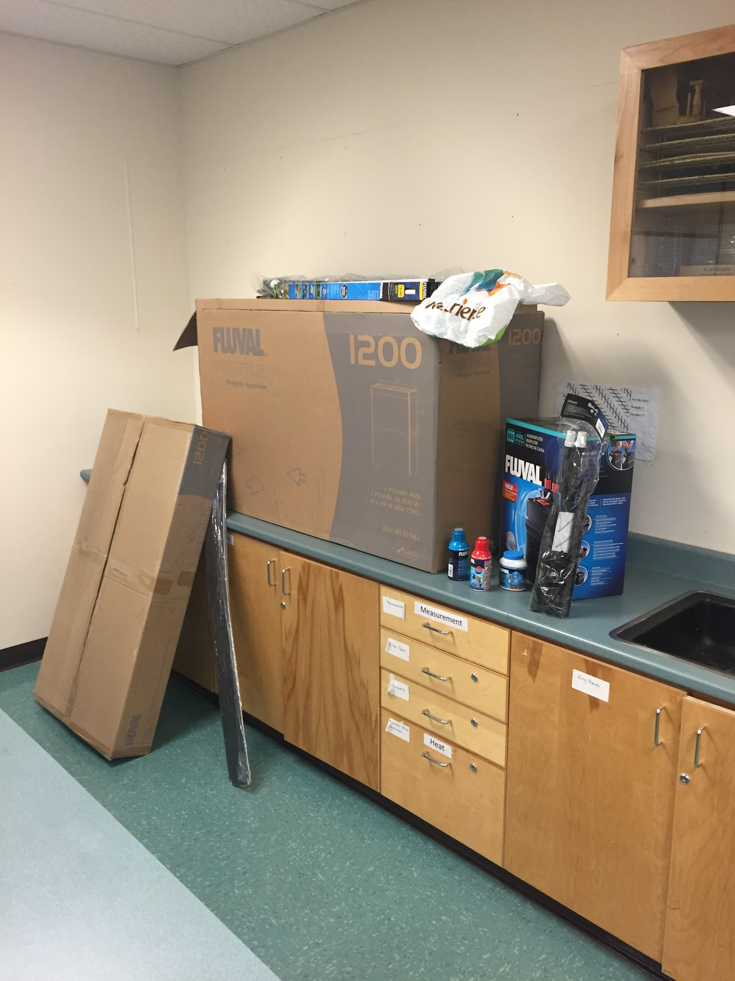
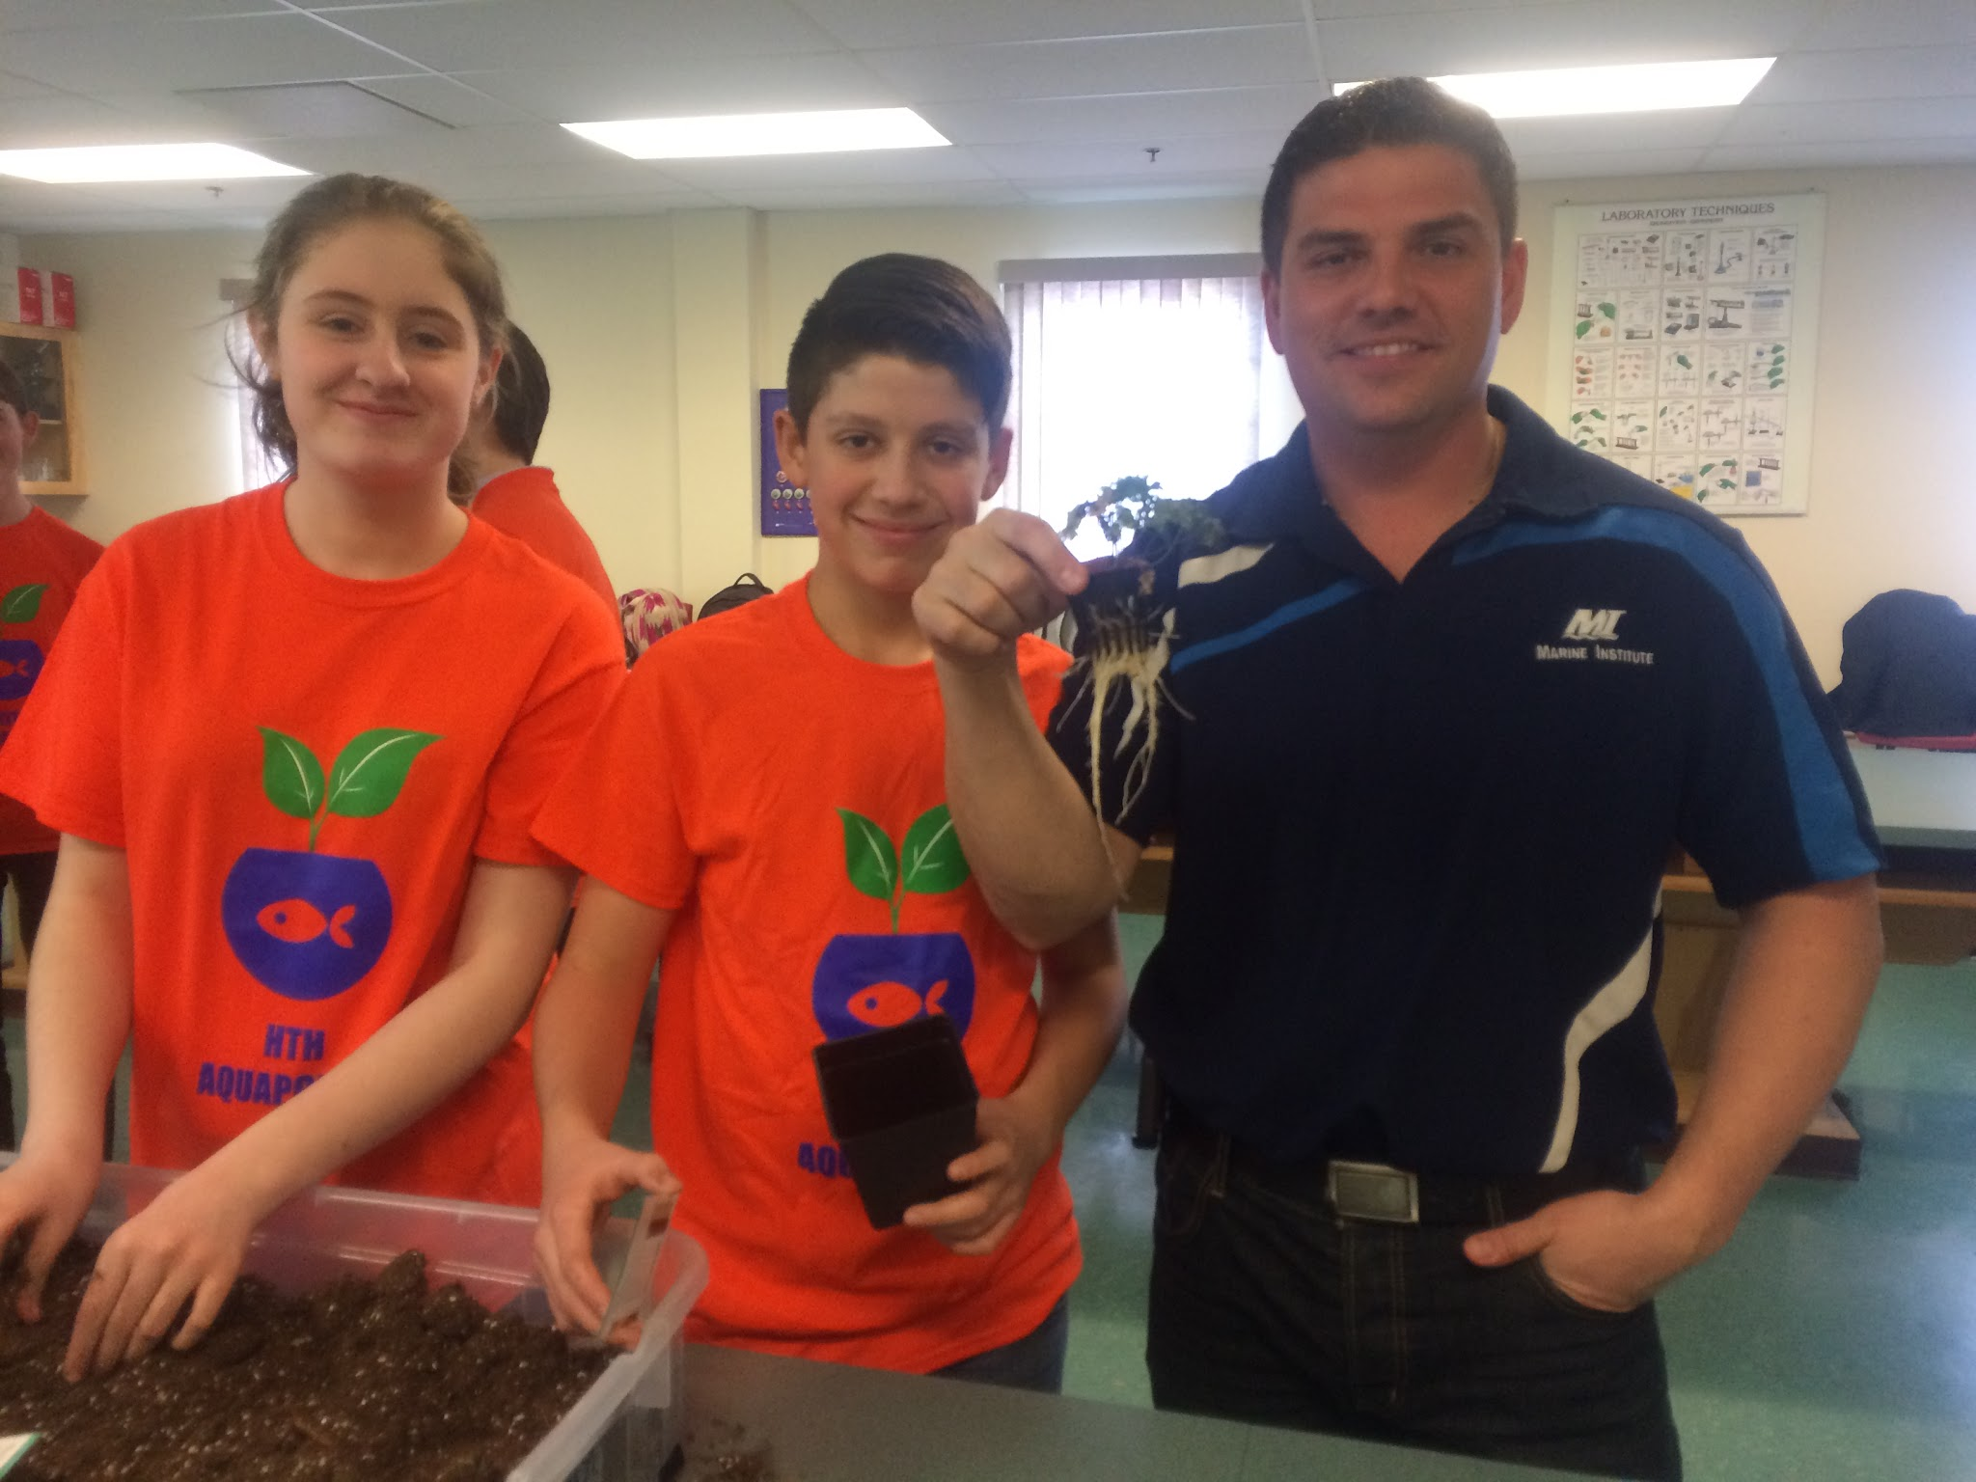
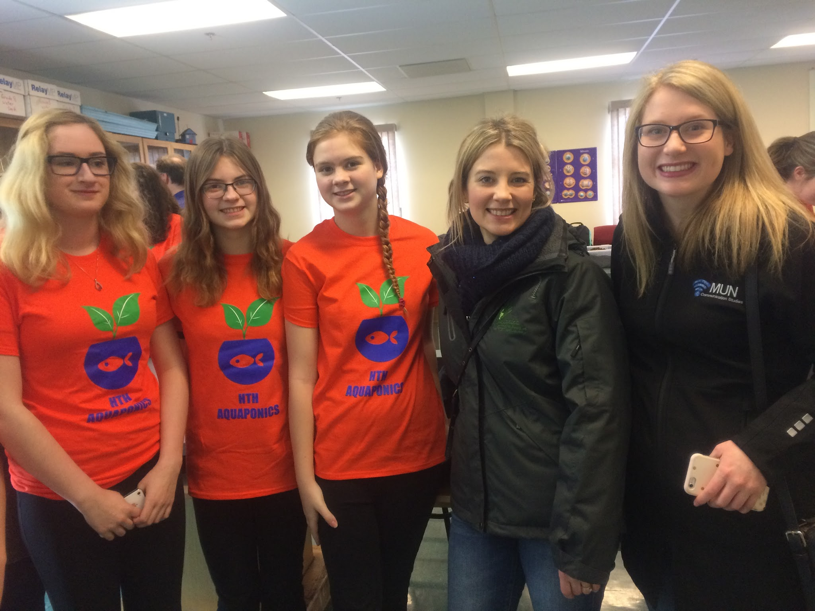
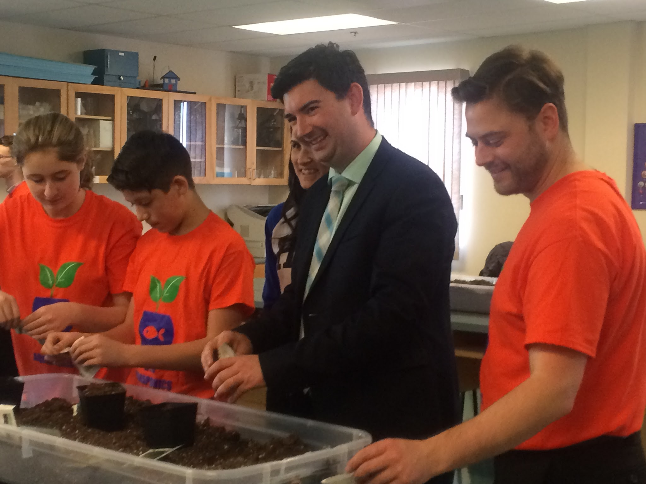
Aquaponics!

Slide 50
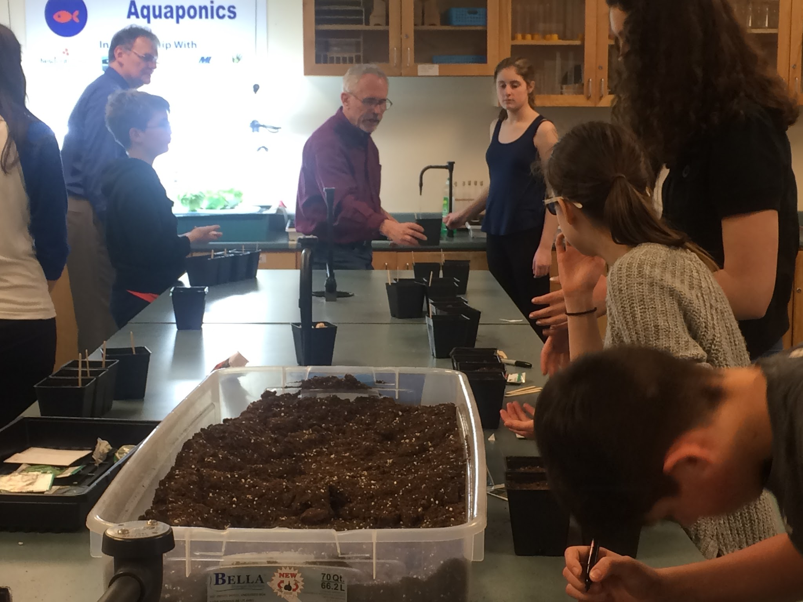
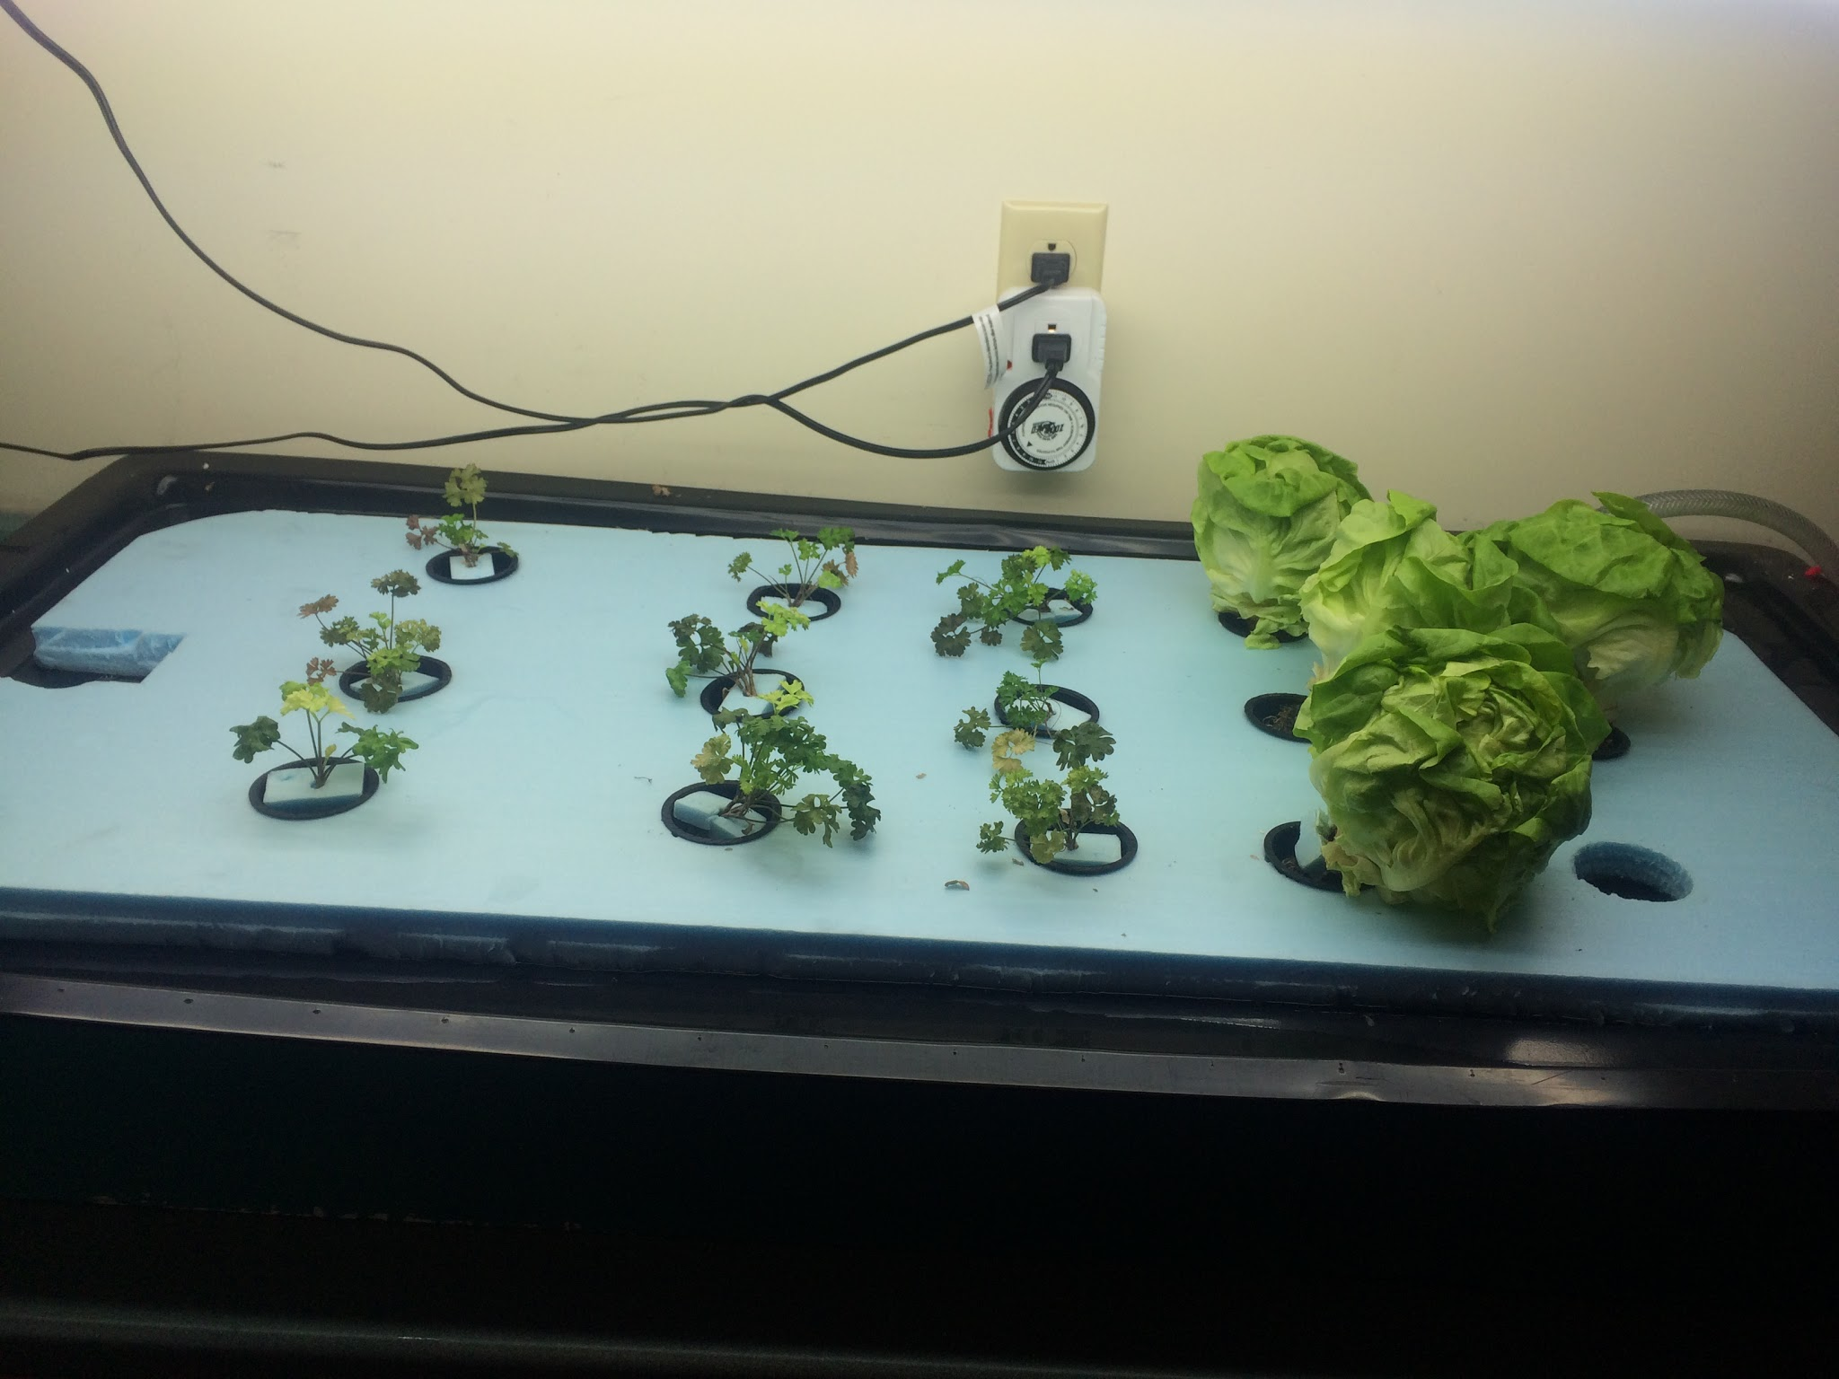
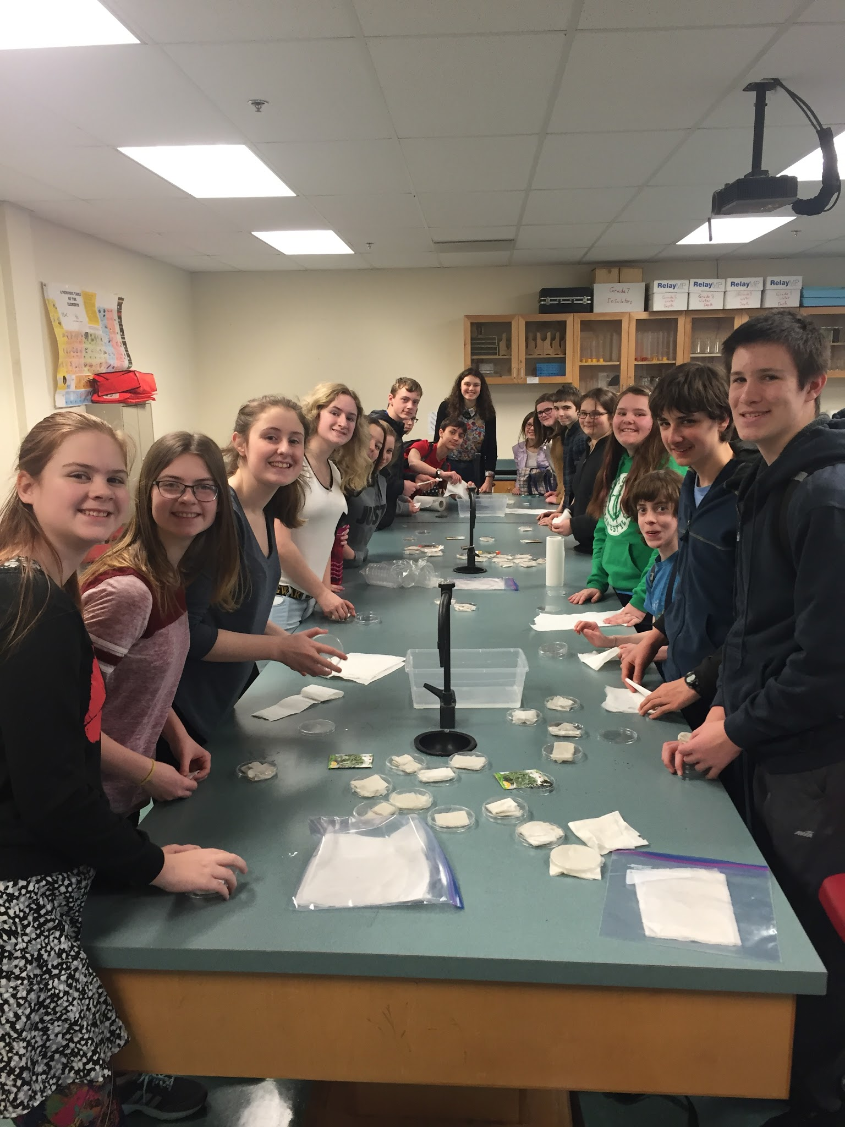
Aquaponics - Agriculture

Slide 51
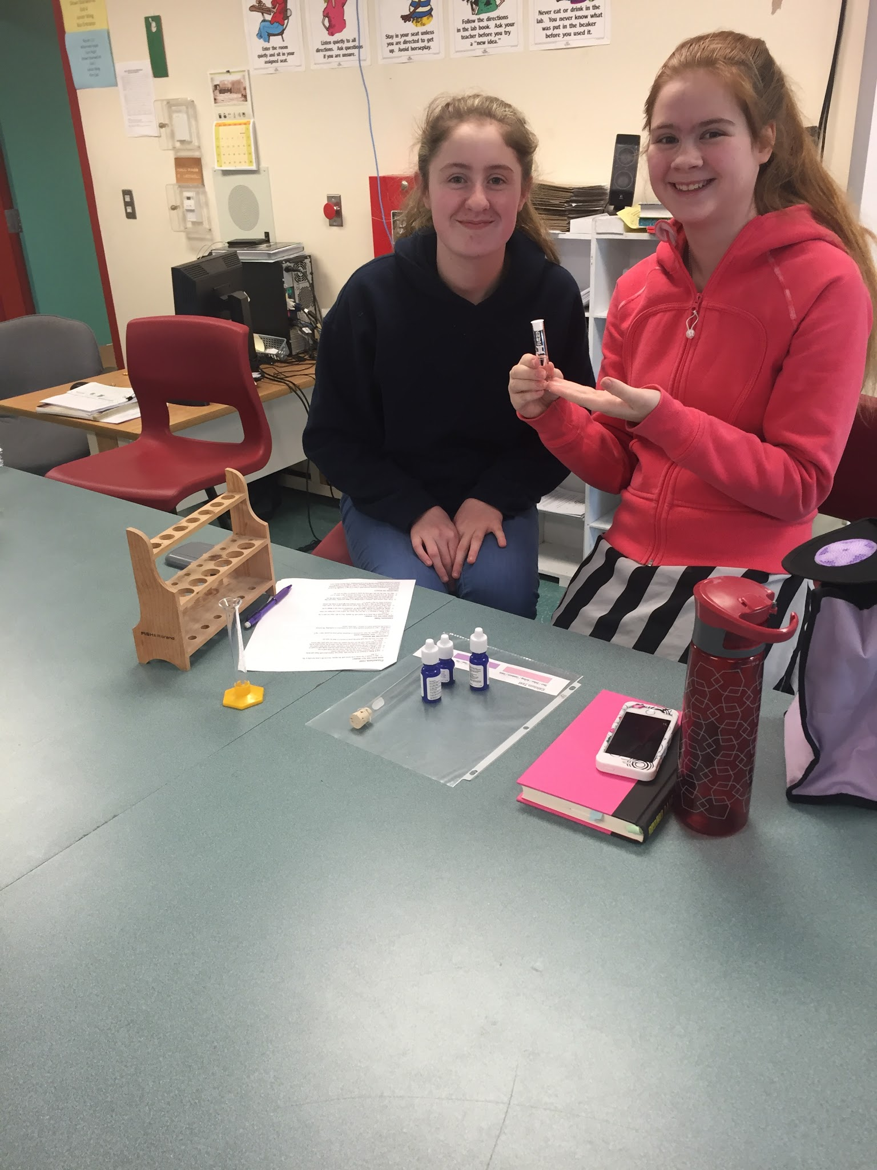
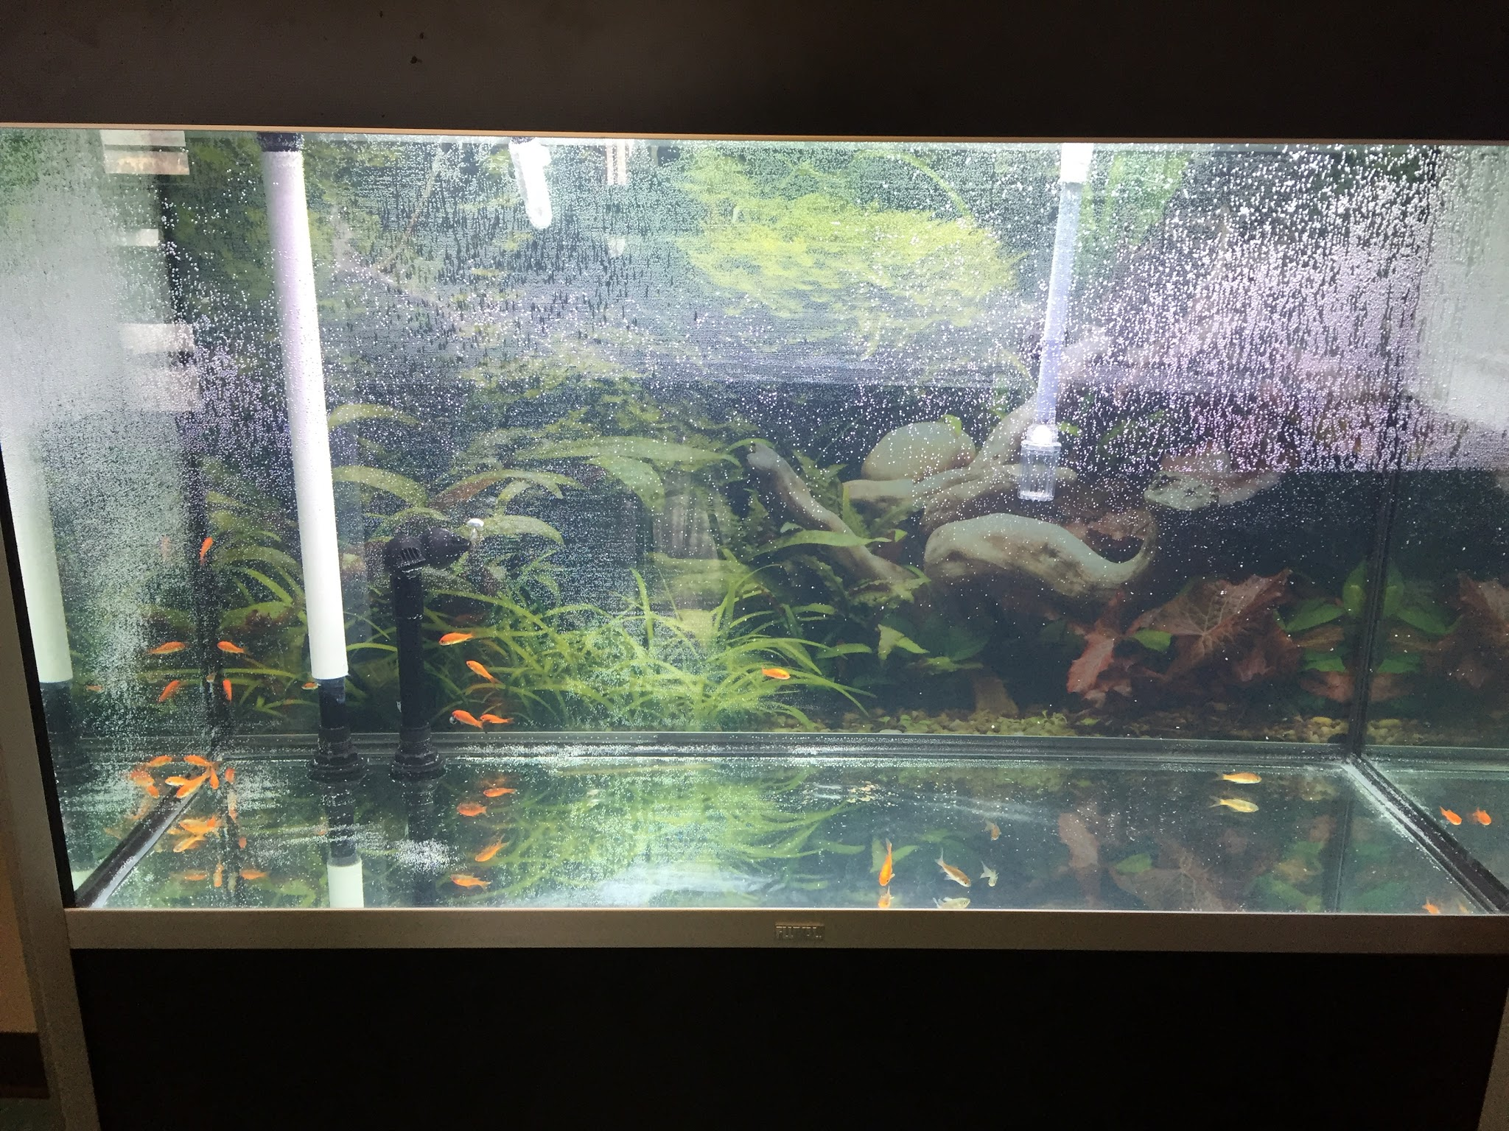
Aquaponics - Aquaculture

Slide 53
Data Collection/Analysis

Slide 54
Research Methods
Video’s
Interviews (parent and student)
Group discussion
Field notes
Reflections
Performance-based testing
Formative testing games (Kahoot)
Outside Observers
Pre and Post-Survey
Notes:
We used video, interviews (parent and student), group discussion, teacher field notes during classes, reflections after classes, performance-based testing, formative testing games (Kahoot), outside observers (principal, parent volunteers) to collect data.

Slide 55
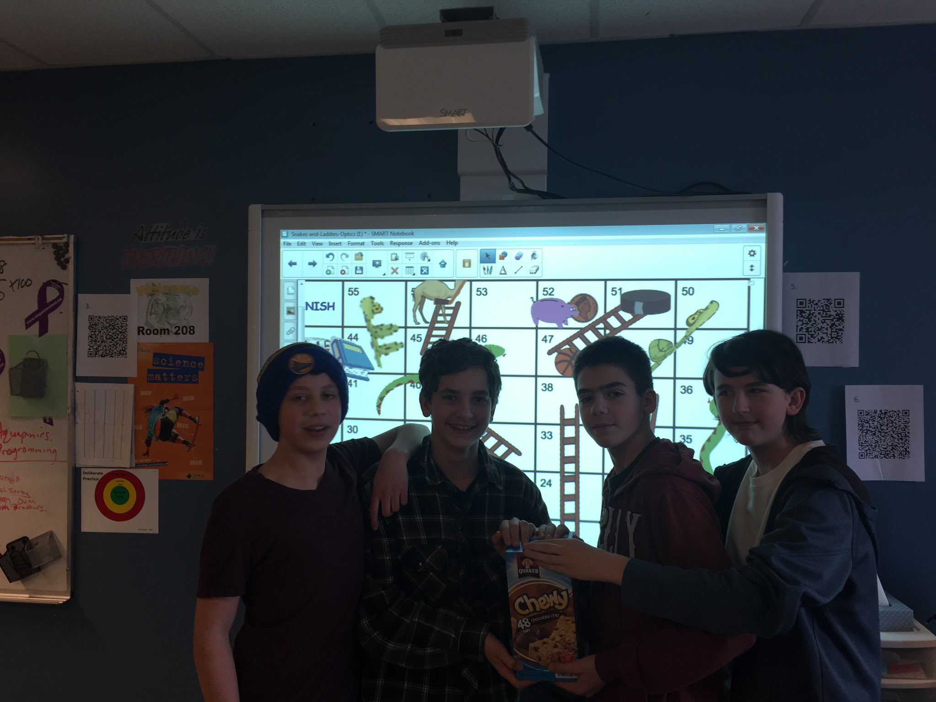

Slide 56
Validity and Reliability
Triangulation
Multiple teachers in different classrooms
Multiple questioning time periods
Information from several sources (teachers/students/parents/volunteers)
Feedback from Grade 8 students not part of the TIA (unsolicited)
Why are they not doing these activities? No pancakes...shoot rockets...etc...
Notes:
Triangulation included multiple teachers in different classrooms, multiple questioning time periods, and information from several sources including teachers, students, parents, volunteers. An interesting component of our data was the unsolicited feedback from students in grade 8 science who were not part of the TIA project who offered up comments like, Why aren’t we doing all these activities?”, “How come they got to make pancakes...shoot rockets...do that density thing with the pill bottle,...” etc.

Slide 57
Data Analysis
Teacher to teacher conversations
Inductively we wondered: Will activities lead to better understanding of concepts?
Through extension, students looked at relationships in a more deductive manner
Notes:
Mostly through teacher to teacher conversations that followed an inductive reasoning reasoning process. This shared discussion was enhanced because we often did activities at slightly different times so we benefitted from observations made the ‘first time through’.
Inductively we wondered if the student making pancakes, dripping streams of fluids down a ramp or racing marble through various liquids, would lead to a better understanding of the concept of viscosity.
Later, through extension -- like the bottle rocket activity, students looked at the relationship between surface area and pressure to see how specific bottles of different size openings, or different volumes of water affected rocket performance in a more deductive manner.

Slide 58
“With scientific inquiry activities, students can gain related knowledge and skill, form the habit of scientific thinking...solve problems by scientific knowledge.” (Liao, Liao, Chiang, Wu, & Liao, 2016).

Slide 59
Results

Slide 60
Enhanced understanding in subject matter
Exploration in-depth on the curriculum as well as external resources on
Fluids
Aquaponics
Optics
New ways to engage students
How to create a deeper understanding
Notes:
We explored in-depth the curriculum and external resources on fluids, aquaponics and optics.
We found many new ways to engage students in these topic areas as well as how to create a deeper understanding and meaning for both them and us.

Slide 61
Enhanced understanding in assessment
Hands-on skills section for formal assessment
Insert picture and include description orally
Notes:
One of the greatest enhancements in our understanding of assessment was when we incorporated an activity of hands-on skills section to a formal assessment. This was both a challenge but also an inspiration for future endeavours into assessing more real-life skills.

Slide 62
Enhanced understanding in instruction
Inquiry based instruction
gradually released the responsibility of learning
At first students often questioned and feared
Many looked for guidance and modelling
With time they gained confidence
Began to explore their on their own.
Notes:
Inquiry based instruction where we gradually released the responsibility of learning to the students was an exciting and new way of teaching that led to many exciting results. At first students often questioned what they should do or feared that they were not doing activities correctly. Many looked for guidance and modelling from the teacher, however, with time they gained confidence in themselves and began to explore their on their own.

Slide 63
Enhanced understanding in student learning
Students can learn a lot with little instruction/guidance
Released responsibility can enhance student confidence
Students were more likely to share with the class, elaborate and compare their views with others
Students wonder and do self-inquiry and activate prior knowledge
Picture of students talking together
Notes:
Since we started inquiry based learning we realized that the students can learn a lot with very little instruction and guidance from us. THe students did resist at first entering a room to explore and come up with the ways that fluids work on their own, but soon they were confident in their own ability to discover the answers on their own. Students seemed more inclined to share their experiences from previous lessons when we would have a follow up discussion. Many students wanted to share what they explored and discovered and liked to elaborate on others ideas. It is made students formulate their thoughts and compare them with others’ views. By adding to constructs they already had instead of one's teacher presented it seemed to enhance their confidence and learning. It made sure that students wonder and do self-inquiry; students activate prior knowledge and present their views.

Slide 64
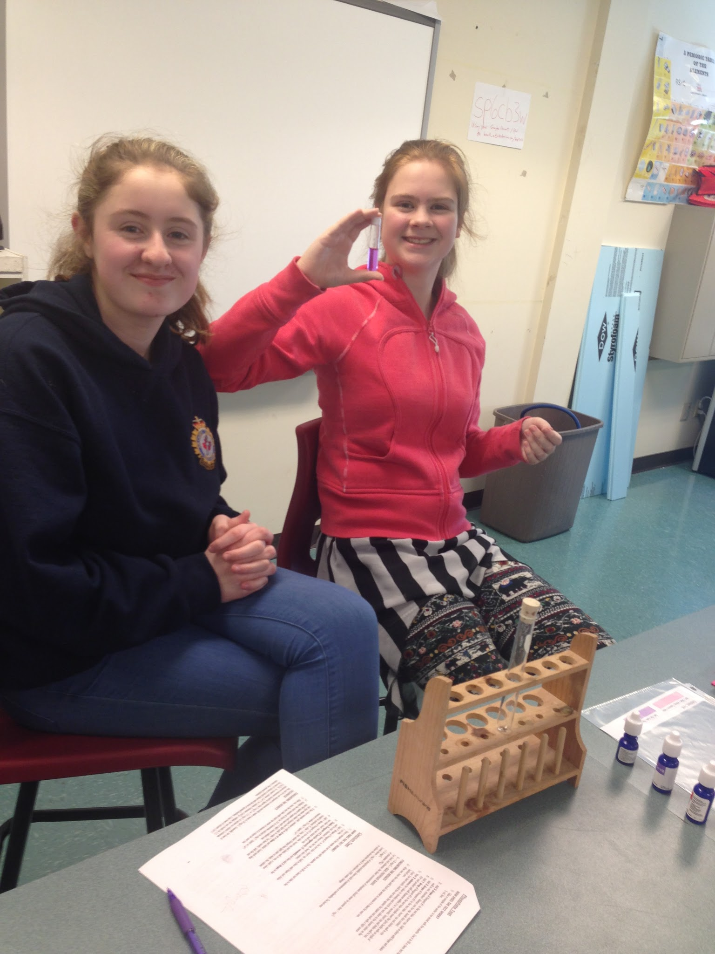
Patterns and Themes
New volunteers
Confidence
Engagement
Get picture students raising hands
Notes:
Students who were not often open to volunteering or giving answers would raise their hands to share their ideas. It seemed the fear of being incorrect had diminished since they knew that they had all tried to explore and discover on their own.

Slide 65
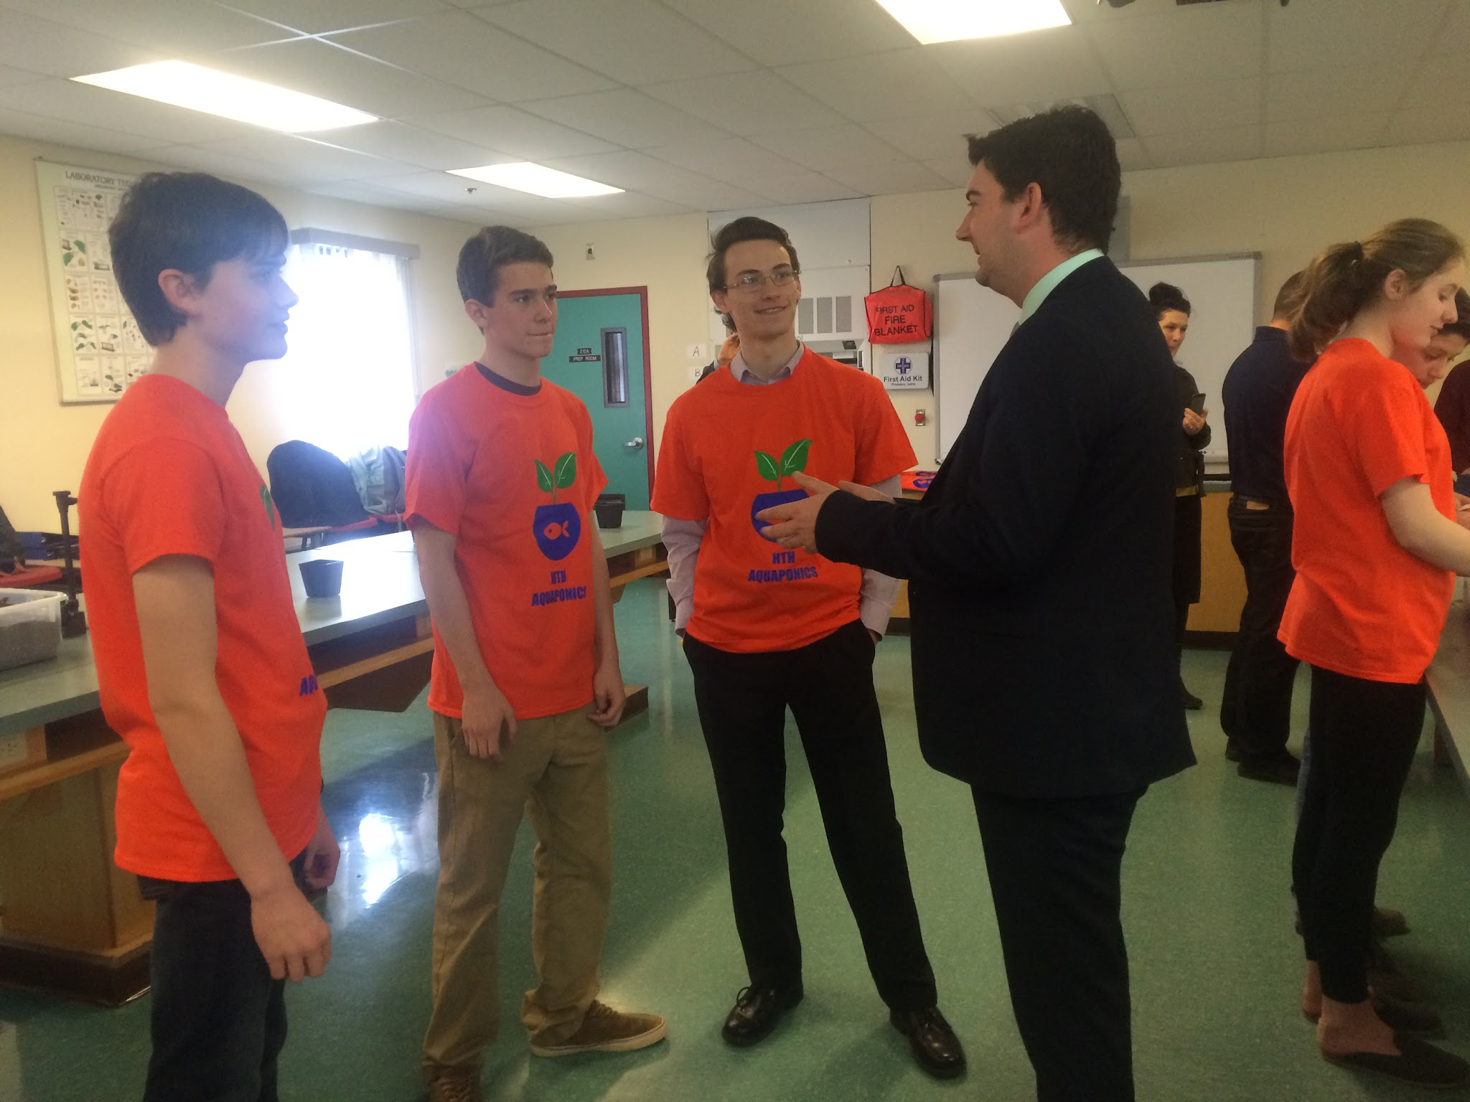
Changes in our classroom practice
More volunteers,
Less fear
More open to explore.
Increased suggestions
Notes:
More volunteers, less fear of not doing things correctly, more open to explore. Increased suggestions from students to “try this” as opposed to just completing the core lab.

Slide 66
Survey Outtakes
What are some materials/tools you use in Science class
Pre-Survey | Post-Survey
Beakers, Test tubes Eye dropper Pencil Paper | Beaker Fluids Microscope Pipets Hot plate Thermometer Bottle rocket Balloons Tug of war rope Graduated cylinders Ramps Timer Salt Scales Models

Slide 67
Survey Outtakes
What I like most about my Science class/ Qu’est-ce que vous aimez a propos de la classe de sciences?
ANSWERS:
Labs! Experiments! Activities !
I can understand the world!
Group activities! My Teacher!
The atmosphere!

Slide 68
Long term impacts on teaching
More student-centered hands-on activities
Inquiry based learning
confidence in its effectiveness
Changes to our assessment.
Notes:
There is no doubt that this project will influence our long term teaching. From having more hands-on activities as well as inquiry based learning (and having confidence in its effectiveness) where the students discover the meanings to changing our assessment.

Slide 69
New questions
How can we include students own interests more into the classroom?
How can we achieve all of the curriculum outcomes yet complete activities in a pace where students achieve meaningful learning?
How can we sustain/create a school environment that supports and reward a student-centered inquiry based learning environment
Notes:
How can we include students own interests more into the classroom. How can we achieve all of the curriculum outcomes yet complete activities in a pace where students achieve meaningful learning?

Slide 70
Teacher Inquiry

Slide 71
How our understanding of teacher inquiry has changed
We were uncertain (nervous?)
Transferable to testing situations?
Difficulty: Letting go of control
Strength:
student-centered learning allowed their curiosity to be peaked,
discover what would happen instead of be told,
left them with a more meaningful learning experience.
Challenge: substitute teachers
Notes:
All three teachers had some experience with inquiry, however we were uncertain (and even maybe a little nervous) to see if true learning would occur. As well as if this learning would be transferable to testing situations. One of the difficulties we as teachers found during inquiry, was letting go of control to allow students to discover what would happen instead of telling them. The strength was that student-centered learning allowed their curiosity to be peaked, they were able to discover what would happen instead of be told, which left them with a more meaningful learning experience. Challenge: Lessons that were well organized and planned could still present challenges for substitute teachers, especially at the beginning of the project since students were also still getting used to the activity based learning.

Slide 72
The future of our teacher inquiry
Inquiry and inquiry based learning is an essential part of our classrooms
Continue to create these learning environments.
Notes:
We believe that teacher inquiry is an important aspect to our classrooms and that inquiry based learning is an effective form of teaching. There is no doubt that there was a tremendous amount of learning by both teachers and students through this project.
Although we may not be able to have as much inquiry as we had during this project (or as much as we would like to have), due to time and monetary constraints, we will continue to create these learning environments to enrich our classrooms.

Slide 73
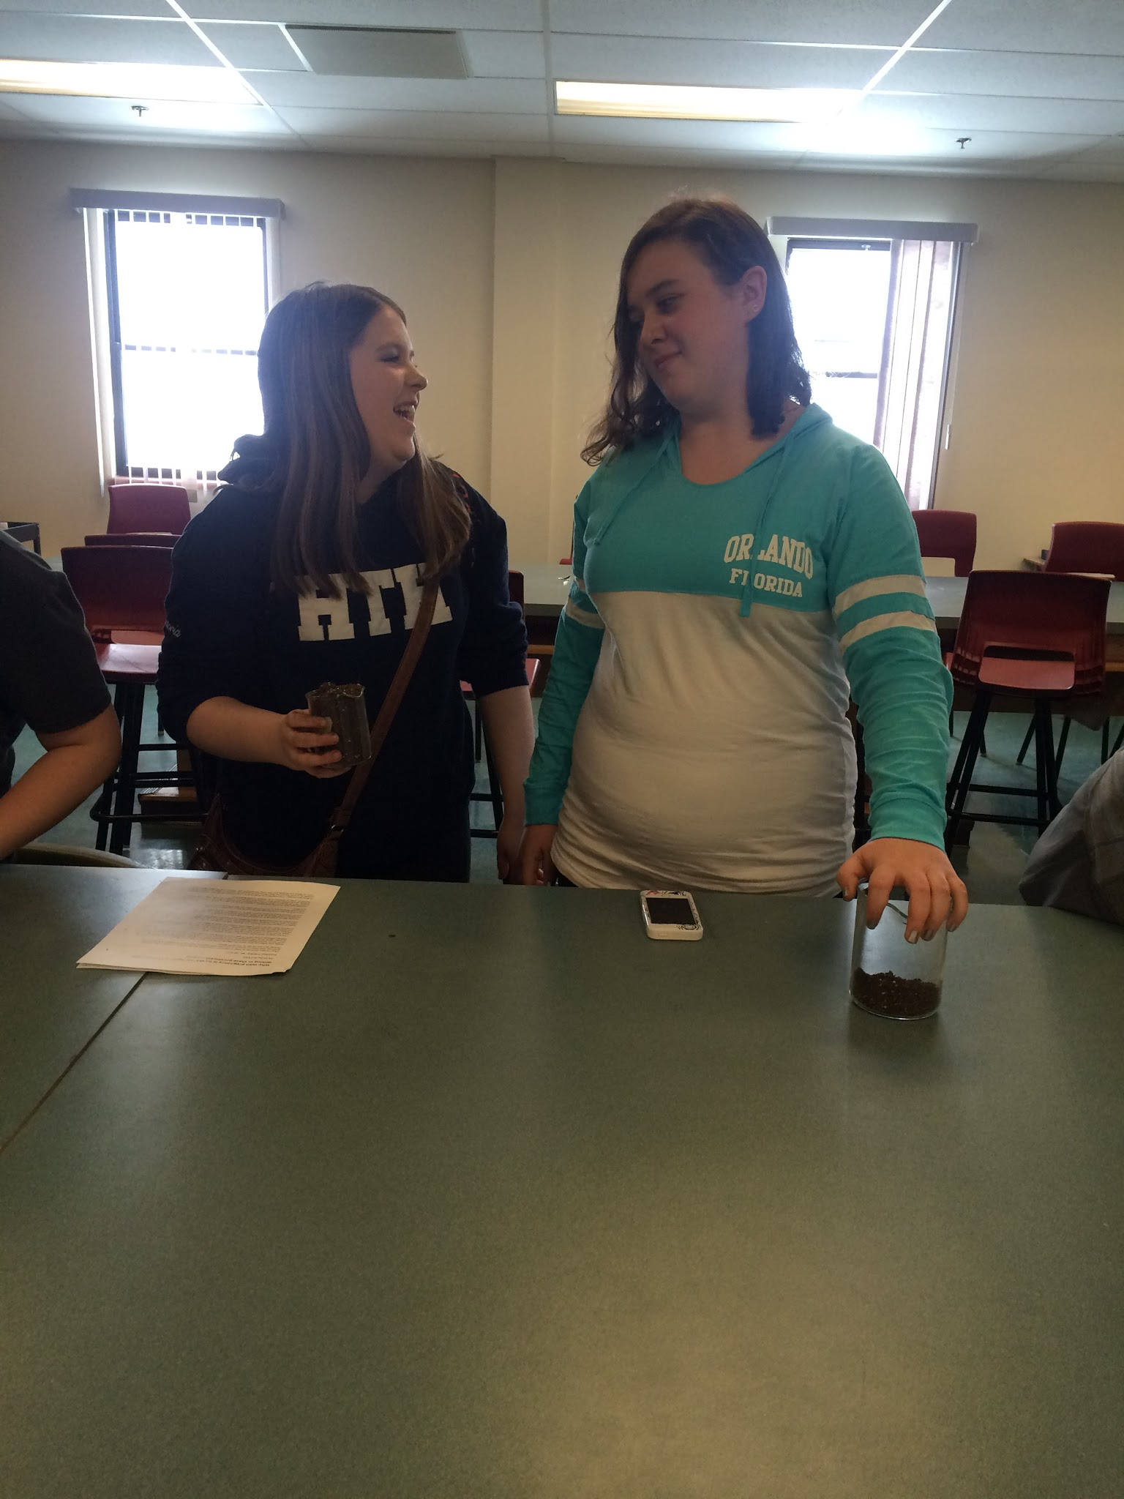
Our Projects Successes
Teachers: Achieved our goals increasing student motivation
Students :
Took part in the learning and sharing environment
more relaxed and confident
Notes:
Yes the project was a success. We were able to achieve our goals increasing student motivation through inquiry based learning through the opportunity to collaborate with colleagues and learn ways of incorporating inquiry based learning into the curriculum and our classrooms. Students who often did not enjoy science class or take part in the learning and sharing environment appeared more relaxed and confident when working with peers in the inquiry based learning projects.

Slide 74
“Through collaborative inquiry, teachers integrate new knowledge and understanding of student learning and classroom instruction into their existing knowledge of professional practice. For those engaged in inquiry, the process can serve to expand and refine their personal knowledge base about what it means to be a teacher” ( Earl, in press.)

Slide 75
Project and professional learning
Creating student-centered learning environments
Allow students to engage, explore and elaborate through inquiry based learning.
Time and resources can put a constraint
Questioning : Activity-based learning vs. Traditional class.
Notes:
We have always been interested in creating student-centered learning environments that allow students to engage, explore and elaborate through inquiry based learning. Often times, time and resources can put a constraint on just how much we can do despite desiring to do more. As educators we may also find ourselves questioning whether we should be spending so much time on activity-based learning or if we should stick to traditional reading, writing and required labs.

Slide 76
Project and professional learning
Allowed us to explore:
How we can incorporate even more activities into our classroom and
If it is beneficial to student motivation in the classroom.
Witnessed our students become more motivated/interested
Enhanced our professional development in Science.
Notes:
This project us allowed us to explore how we can incorporate even more activities into our classroom and if it is beneficial to student motivation in the classroom. We witnessed our students become more motivated/interested in our classroom activities as their engagement and understanding increased. Enhanced our professional development in Science.

Slide 77
Student centered learning environments
Time is always a constraint
This project allowed time for planning to make these environments
New ways of integrating curriculum into the classroom
As teachers we took the role of observer with background probing.
Enabled students to develop higher order questioning skills.
Notes:
Time is a constraint for many teachers when it comes to planning lessons. Given that this project allowed us time for planning and organizing activities we were able to create more lessons that enabled our classroom to be student-centered learning environments. We were able to find new ways of integrating the curriculum in our classroom. Student centered learning took place while the teacher was able to take on a role as an observer in the background probing, elaborating and formatively evaluating student learning. This student-centered learning environment enabled students to develop higher order questioning skills. With the group work that took place in most lessons student-centered learning was easier with the support of their peers.

Slide 78
“Collaborative inquiry holds potential for deep and significant change in education.” (Butler & Schnellert, 2014)

Slide 79
References/Credits
Ryan, R.M., & Deci, E.L. (2000). Intrinsic and extrinsic motivations: Classic definitions and new directions. Contemporary Educational Psychology, 25, 54–67.
Earl, L. (in press). Educators as knowledge leaders. In Robertson & Timperley (Eds.), Leadership and learning. Thousand Oaks, CA: Sage Publishing.
D.L. Butler, & L. Schnellert “Collaborative Inquiry Empowering teachers in their professional development” Journal of Educational Change (2014), online publication.
Liao, C., Liao, Y., Chiang, Y., Wu, H., & Liao, Y. (2016). Integrating Scientific Inquiry Learning into Project Course of Vocational High Schools to Construct and Verify Core Competency Indicators. IJIET International Journal of Information and Education Technology, 6(10), 836-842. doi:10.7763/ijiet.2016.v6.802

